Slide 1
Enhancing Your Investigative Skills: Interviewing Alleged Perpetrators A Multi-Module Virtual Course
In the chat box please write:
your name, county, and role,
number of alleged perpetrators you estimate you have interviewed
We create experiences that transform the heart, mind, and practice.

Slide 2
The Academy is a project of San Diego State School of Social Work.
Serving over 20,000 health and human services professionals annually, the Academy’s mission is to provide exceptional workforce development and learning experiences for the transformation of individuals, organizations and communities.
We create experiences that transform the heart, mind, and practice.

Slide 3
About APSWI & The Academy
Adult Protective Services Workforce Innovations (APSWI)
Training program of the Academy for Professional Excellence, a project of the San Diego State University School of Social Work.
APSWI provides innovative workforce development to APS professionals and their partners.
The Academy provides workforce development and learning experiences to health and human service professionals.
Academy Programs include:
We create experiences that transform the heart, mind, and practice.

Slide 4
Overview of Technology
Video camera
Mute, unmute
Chat box
Hand clap/thumbs up
Icons to indicate facilitator needs to slow down or you need a break
If you must step away briefly…
Technical problems with technology

Slide 5
Course Overview
This course is adapted from an all-day in-person course developed by Candace Heisler, JD with some new content.
Multi-Modules.
Module 1 is about 2 hours in the virtual classroom.
Module 2 is an individual practice and will take approx. 45 min. This will be completed on own before you attending Module 3.
Module 3 is about 2.5 hours in the virtual classroom.
Course is interactive and includes:
Poll Questions
Questions/responses using chat box
Group discussions
Break out groups
Role plays

Slide 6
Course Goals and Objectives
Enhance your ability to effectively interview alleged perpetrators (A/Ps) of abuse, neglect, and exploitation of older and vulnerable adults by improving your ability to:
Identify at least three goals an APS professional has when interviewing an A/P
Develop a method for planning and organizing the interview
Using a scenario, demonstrate the ability to identify potential justifications and defenses and develop questions to address them
Identify and implement strategies to maintain control of an interview of an A/P in order to achieve its goals

Slide 7
Poll Question
Pick your top concern.
What is your greatest concern when conducting an effective A/P interview?
Notes:
a. My safety
b. Client’s safety
c. They won’t talk to me
d. I do not know what to ask
e. Other

Slide 8
What Has Worked?
What have you seen or done that has been effective?
Chat Box: Share your ideas and be prepared to verbally discuss further

Slide 9
Interviewing Goals
Interviewers may have a variety of goals when interviewing an A/P.
Think about your goals when interviewing an alleged perpetrator.
What are your top two goals?
Please write answers in chat box but do not hit enter until asked to do so.

Slide 10
Why Do You Interview A/Ps?
Gather or substantiate facts
Get A/P’s explanation for events
Establish what happened
Stabilize/ensure safety by assessing whether A/P should continue to play a role in client’s life and if so, what role.
Assess A/P’s needs and abilities in light of any continuing role, motivation, danger posed to the client, APS professional, and others
Educate A/P, offer resources and services
Assess the A/P’s willingness to work with APS to improve situation
Put A/P on notice of acceptable conduct

Slide 11
Summary Points
APS’ role is not to get a confession but to have a conversation with a purpose, not to establish guilt for a crime.
Your opportunity to assess A/P’s willingness and appropriateness to continue to play a role in your client’s life and to enhance your client’s safety.
Stay in your role, you are not an agent for law enforcement.

Slide 12
Safety Considerations
When interviewing an A/P there are many sources of potential danger.
Must maintain focus on safety of yourself and client when interviewing the A/P
You are about to interview Brenda, your client’s daughter.
Work with your group in your breakout room for 15 minutes, and identify your safety concerns specific to the interview and how you would manage them.
Your client, age 78, lives with her daughter, Brenda who has a history of hoarding behaviors. The home is so cluttered that it is difficult to enter and leave the apartment. The utilities have been turned off for nonpayment of bills so Brenda has run electrical cords to the neighboring apartment. There are rats in your client’s apartment and they are invading other units in the building.

Slide 13
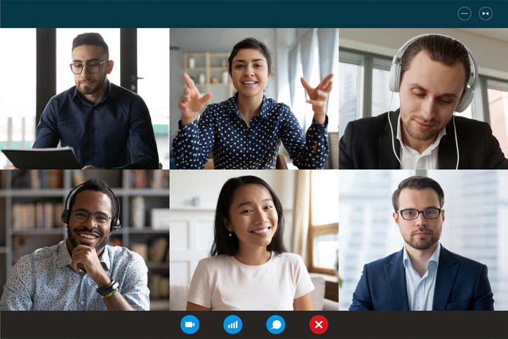
Reports Back
Group Reports
Your client, age 78, lives with her daughter, Brenda who has a history of hoarding behaviors. The home is so cluttered that it is difficult to enter and leave the apartment. The utilities have been turned off for nonpayment of bills so Brenda has run electrical cords to the neighboring apartment. There are rats in your client’s apartment and they are invading other units in the building.

Slide 14
Anticipate Dangers; Take Precautions
A/P has tactical advantage, knows the location, and where dangerous items are located
Check location and known parties with LE and APS files before you respond
Decide if you should make an announced or unannounced visit, go alone, or with a co-worker or LE
Think about locations outside the home for conducting the interview e.g., porch
Interview A/P alone, away from anyone at the location
Memorize safe exits when entering home
Scan for areas that could hide a weapon

Slide 15
Anticipate Dangers; Take Precautions (continued)
Preprogramed phone to 911 if workable in area
Staff/office check in and check out procedures
Park where not be blocked in; avoid standing in front of the door when gaining entry
Protective Equipment
Remove animals
Avoid places with known dangers- e.g., kitchen, workshop
Trust instincts—leave if not safe, or there is no safe place to talk
Biological:
Communicable Disease
Bodily Fluids
Needles
Chemical:
Precursor Drugs/ Meth Lab

Slide 16
Understanding the A/P’s Perspective
What does the A/P need from you if the A/P is to participate in the interview with you?
To respond, physically raise your hand or use the thumbs up icon.
If you fail to consider the A/P’s needs, you may never build rapport or get the A/P to speak with you. You may miss a critical opportunity to learn about and address A/P expectations and biases that may be counterproductive to the interview or your client’s interests.

Slide 17
Building an Environment for Disclosure
Build trust with A/P—
Must think that you are interested in what they are saying, are neutral and objective, empathetic
Must believe that what they have to say is important and will be fairly considered
Honesty
Who you are
Why you are there

Slide 18
Organizing the A/P Interview
Do you plan your A/P interview in advance?
Need a clear plan to the interview
Ordinarily interview late in the fact gathering stage—one opportunity, may not be others to go back and clarify
Get the facts before moving to problem solving and education
See Tip Sheet

Slide 19
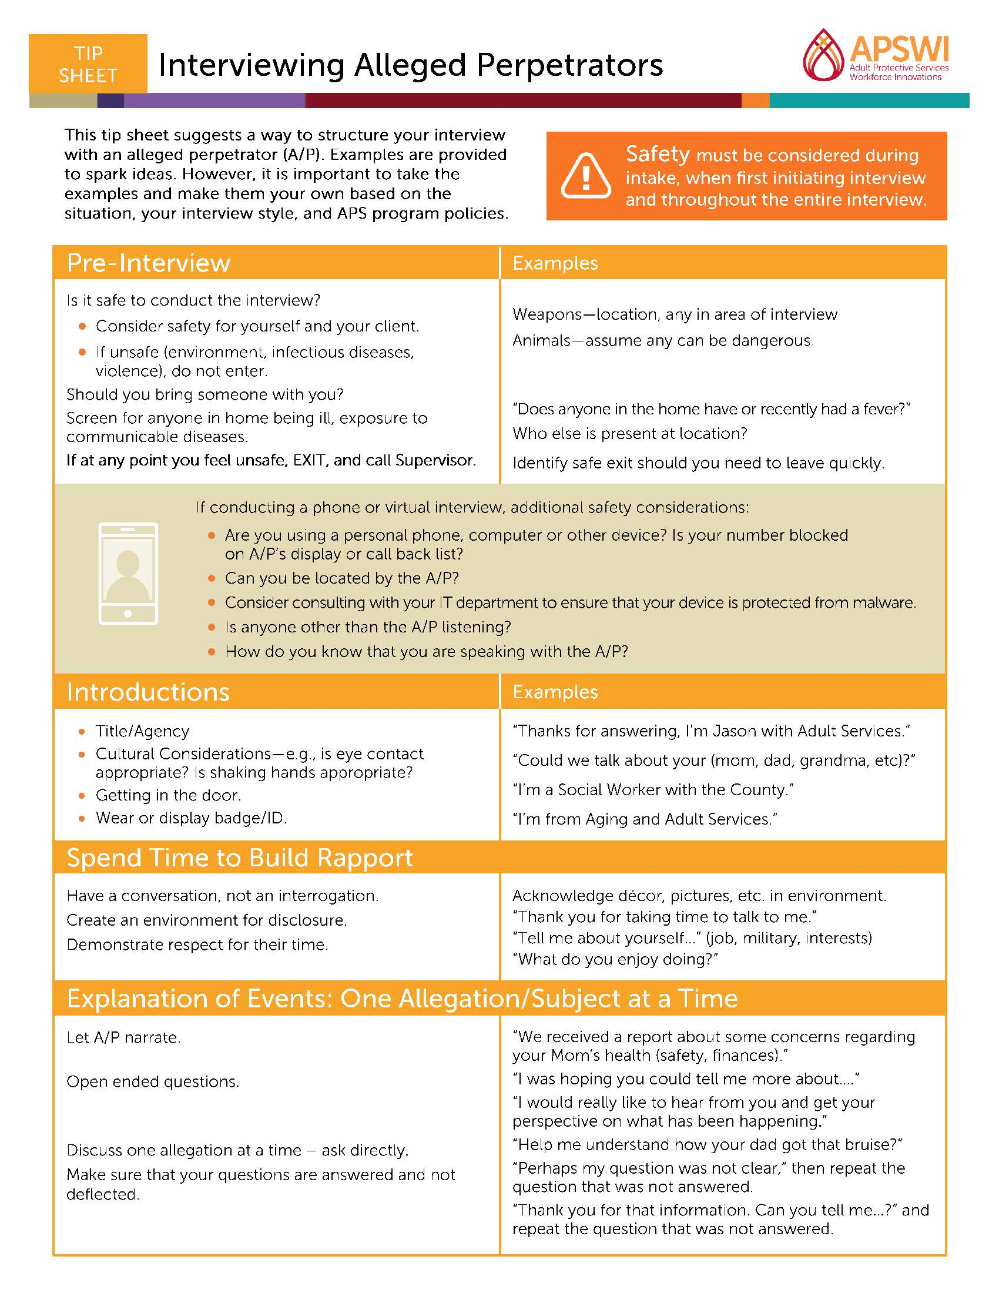
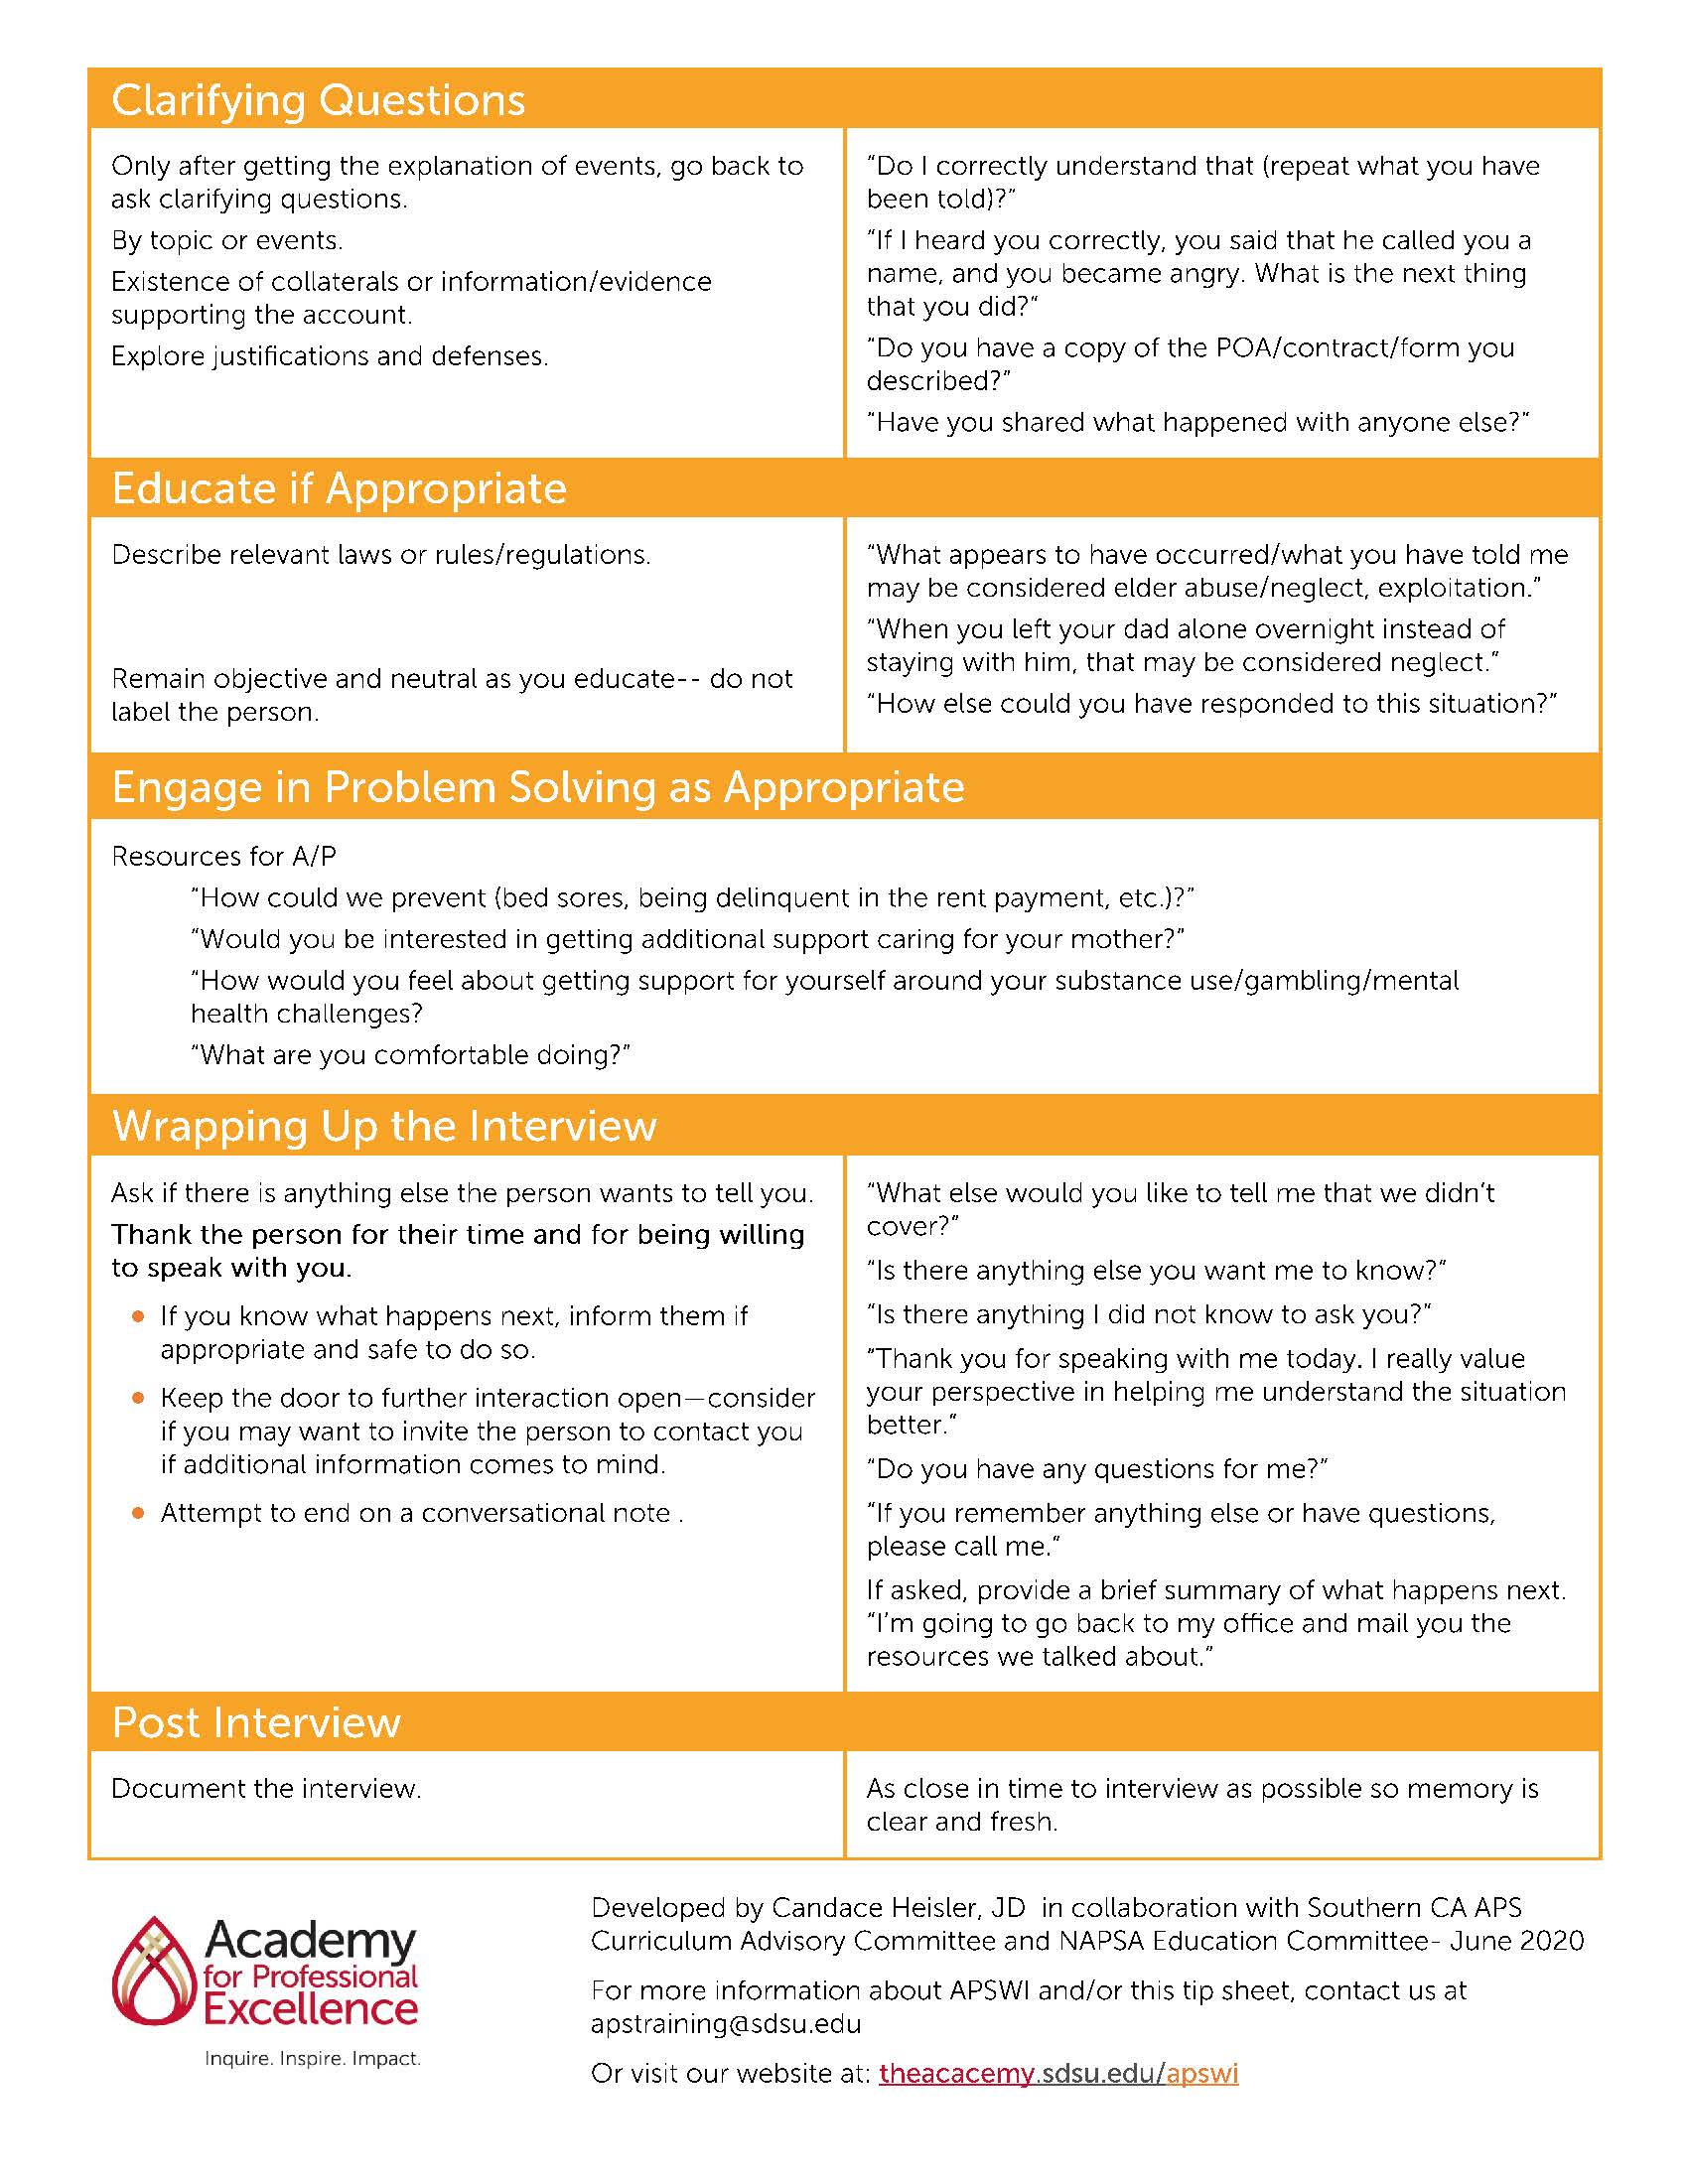
Interviewing A/P Tip Sheet

Slide 20
Tip Sheet

Slide 21
Tip Sheet continued

Slide 22
Concluding Module 1
Today’s Module
Goals of Interviewing A/Ps
Safety Considerations
Planning and Organizing the Interview
Introduce the Interviewing A/P Tip Sheet

Slide 23
Overview of Module 2- Individual Practice: Handout #2
Locate Handout #2
Can be completed immediately after logging off from Module 1.
Provides you time to work at your own pace and develop interview questions on your own.
Handout #2 must be completed before we convene for our next virtual classroom, Module 3.
Will be used in next virtual classroom for activities.
Expected to take 45-60 min.
You will need the Tip Sheet and Handout #2 in your Participant Manual.
Once completed, log into the Module 2 on-line learning activity and record for credit.

Slide 24
Individual Practice – Handout #2
Individual Practice Assignment
Based on the case study in Handout #2:
1. Develop 4-6 questions or ways to build rapport with David.
2. Develop 4-6 questions to explore possible defenses or justifications David may offer to the allegations.
We will use your individual practice work in the final module of the course.
What questions about Module 2- Individual Practice do you have?

Slide 25
Thank You!
Follow us on Social Media:
@SDSUAcademy
@Acad4ProfExcell
@sdsu-academy-for-professional-excellence/
@TheAcademySDSU

Slide 26
We envision a world where the quality of life for individuals, organizations, and communities is transformed to a healthier place.
Change background color of this block in title slide to match primary program color (color intertwined with the red in the logo and color of acronym font)

Slide 27
Enhancing Your Investigative Skills: Interviewing Alleged Perpetrators A Multi-Module Virtual Course
In the chat box please:
Write your name and county
Any questions from Module 1 and 2 you would like answered before moving on.
We create experiences that transform the heart, mind, and practice.

Slide 28
Poll: Course Review
Pop Quiz

Slide 29
Module 3 Content
Conducting the Interview
Building rapport
Asking about the alleged abuse
Addressing defenses and justifications
Dealing with volatility
Ending the interview
Please have the Tip Sheet and completed Handout #2 available.

Slide 30
Building Rapport Activity
How can you use body language and other cues to build rapport?
Write ideas in chat box but do not hit enter.
Return to the case scenario you worked with in the Individual Practice. Please find the questions you developed to build rapport.
Who will share the questions you developed?

Slide 31
Goals of Rapport Building
Build trust with the A/P
Encourage A/P to participate in the interview
Educate the A/P in APS professional’s goal and role
Demonstrate respect for A/P
Provides a way to better understand communication style
Gain insight into their values and beliefs
Better understand how they view your client
Understand motivations and willingness to make needed changes

Slide 32
Encouraging Complete Responses
Goal of an interview is to get A/P to provide complete information which is not just a yes or no response
Open ended questions
Tell me about yourself
Tell me about your father
How did your father come to live here?
How did you become his conservator/guardian?
How does that seem to be working out?
Can you give me an example of that?
What are the best parts of the relationship?
Some might find this situation stressful. Do you? How do you deal with the stress?
Nonverbal Communication to encourage

Slide 33
Exploring the Incident
In your breakout groups:
You have already built rapport with David and are now ready to ask him questions about what happened.
Together, choose a single form of abuse (Caregiver Neglect, Emotional or Financial Abuse)
Take 3 minutes working individually to develop interview questions to establish his version of what happened. Then, select 2 interviewers from your group and one person to play the A/P. Practice asking your questions. Then switch to allow for the person who played David to now be the interviewer.
Practice for a total of 10-12 minutes.
If you are playing the A/P, answer as you feel he would.
The goal is to have everyone interview at least once.
Choose a lead who will report out to the larger group.

Slide 34
Debrief of Activity
Did anyone ask about possible neglect?
What questions did you ask?
Did anyone ask about possible financial abuse?
What questions did you ask?

Slide 35
Reminders
Begin with open ended questions to encourage narrative responses
Create an environment for disclosure
Challenge responses with care and not at the beginning
Do not collude with bad behavior
Explore defenses and justifications

Slide 36
Anticipating Defenses
The more we have the ability to put ourselves in someone else’s situation the better we will be at anticipating possible justifications and the more effective we will be preparing to conduct the interview.
Put yourself in David’s position, what defenses or justifications would you offer?
Neglect
Emotional abuse
Financial abuse

Slide 37
Defenses and Justifications Deep Dive
In breakout groups, you will be assigned one form of abuse (neglect, financial abuse, emotional abuse)
Check the chat box for form of abuse assigned to each group #.
Work with your partners and develop 3 questions to explore your assigned defense as though you were interviewing David in the case study. You have 7-8 minutes.
Look at the questions you developed in your individual practice on defenses and justification to get you started.
Assign a recorder to report back to class.

Slide 38
Defenses and Justifications: Follow Up Questions
Who else knows about this?
Who did you tell about this?
Who have you spoken with since this happened?
Did you do anything after this happened?
Did you seek any assistance/medical care, etc.

Slide 39
Addressing Volatility
At some point A/Ps may become emotional and lash out.
How you respond will determine if you can control the interview and if it is safe to continue.
In chat box, briefly describe a volatile situation you experienced during an A/P interview (or client/collateral) and what you did to manage it.
Do not hit enter until you are asked to do so.

Slide 40
Addressing Volatility: Summary Points
Person may have lost control of self—does A/P have anger or control issues and is this how they deal with your client?
Is this a choice to derail the interview, to get you to change topics to something more comfortable, or to control the interview?
Stay calm.
Take control and ask A/P to lower voice.
Remind A/P of importance of the information they are providing and that you are not taking sides.

Slide 41
Addressing Volatility: Summary Points Continued
Offer possibility of providing help to them.
Change the line of questioning and move to less upsetting subjects and then come back to what was upsetting.
If unsuccessful in deflecting the A/P’s anger or volatility, take a short break or end the interview.
Leave if you feel unsafe
Reschedule interview or conclude the interview
If you are concerned for your own safety or your client’s, leave and contact your supervisor
Consider in extreme situations if you should contact LE or behavioral health
If the A/P asks to speak to an attorney, follow agency policy.

Slide 42
De-escalation Skills
Use active listening skills to keep interview going. Keeps your tone neutral and communicates to the A/P that you are really listening and care about what the A/P is saying.
Minimal Encouragers
Open Ended Questions
Mirroring/Reflecting
Emotion Labeling
Paraphrasing
“I” Messages
Effective Pauses
Summarizing

Slide 43
Ending the Interview
Give thumbs up icon to share verbally or type in the chat box answers to the following:
How would you end the interview with David, the son?
Are there other things you typically do to conclude an A/P interview that have not been mentioned?

Slide 44
Ending the Interview, Continued
Thank the A/P for speaking with you.
Effective questions:
Is there anything I should have asked you that I did not?
Is there anything else you want me to know?
If appropriate, tell the A/P what will happen next in general terms, describing only what is in your control, not what other agencies will or will not do.
E.g., I will write up my interview notes…I will discuss with my supervisor…etc.
Do not forget to promptly document the interview, including date, start and end time, location, everyone present, and what you learned.

Slide 45
Interviewing A/Ps Summary Points
Keep interview professional in tone; maintain your professionalism
Do not get “personal”
Focus on the conduct, not the person you have interviewed
Safer for client if A/P is not angry
Fewer complaints or challenges you will have to face
Helps keep the interview and your reaction to the individual (positive or negative) neutral and objective
Keep the door open
Will you or another APS professional need to interview this person at a later time on another case? A/P’s level of cooperation will be related to how you treated them
Tell them what to do if they think of additional information.
Prepare for cooperative problem solving and/or offer of services

Slide 46
Conclusion
Final questions– take self off mute
Final Activity –write in chat box
What is one thing you will use in your work that was covered in this course?

Slide 47
Thank You!
Follow us on Social Media:
@SDSUAcademy
@Acad4ProfExcell
@sdsu-academy-for-professional-excellence/
@TheAcademySDSU

Slide 48
We envision a world where the quality of life for individuals, organizations, and communities is transformed to a healthier place.

