Slide 1
VOLUNTARY CASE PLANNING (Blended with eLearning)

Slide 2
About APSWI & The Academy
Adult Protective Services Workforce Innovations (APSWI)
Training program of the Academy for Professional Excellence, a project of the San Diego State University School of Social Work.
The Academy provides workforce development and learning experiences to health and human service professionals. Programs include:

Slide 3
Housekeeping
Location of restrooms
Set cell phones to vibrate
Please return promptly from breaks and help us keep to the schedule
Materials
PowerPoint Slides
Participant Materials

Slide 4
Team Based Learning
“Team-Based Learning – A special form of collaborative learning using a specific sequence of individual work, group work and immediate feedback to create a motivational framework in which students increasingly hold each other accountable for coming to class prepared and contributing to discussion.”
Michael Sweet

Slide 5
Team Based Learning - DOs
All participants are expected to have completed the Voluntary Case Planning in APS eLearning
DO:
Work as a team
Identify the best answer or most accurate or complete plan
Utilize the unique skills of your team-mates
Use your Smartphone (if you have one) to look up information
Vote on team decisions
Evaluate your team mates’ strengths and use them as resources

Slide 6
Team Based Learning – DON’Ts
Don’t:
Look for other teams to provide an answer
Work as individuals
Be afraid to be wrong
Pressure other team members to think as the majority does. Vote on team decisions
Expect the facilitator to teach during this session

Slide 7
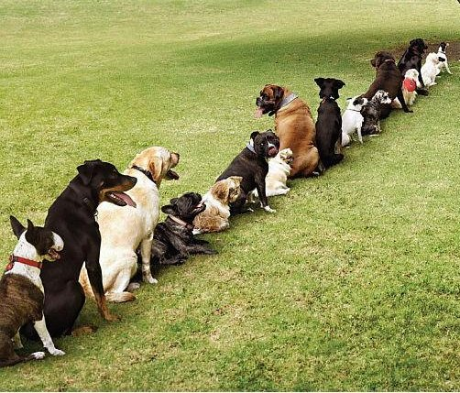
Creating Teams
How long have you been in APS?
4 years or more?
3 years?
2 years?
6 months?
Not from APS, but have experience with older adults?
Not from APS, but have experience with persons with disabilities?
…Line up as directed.

Slide 8
Team Names & Learning Objectives
Identify the factors that influence
intervention needs
Discuss strategies to engage the
victim in developing mutual goals
to decrease risk of abuse
Determine appropriate interventions that
would decrease risk of abuse
Explain when and how to use a Domestic
Violence Safety Planning tool

Slide 9
eLearning Recall
Perpetrator Risk Factors:
Relationship, Dependency, Motives, Threat Level
Stages of Receptivity to Intervention
Reluctance, Recognition, Rebuilding
Client’s Strengths:
Hardiness and adaptive skills
Survival skills
Willingness to learn and use resources
Loyalty and forgiveness, kindness and compassion
Strong faith or religious values
Creativity
Tangible strengths

Slide 10
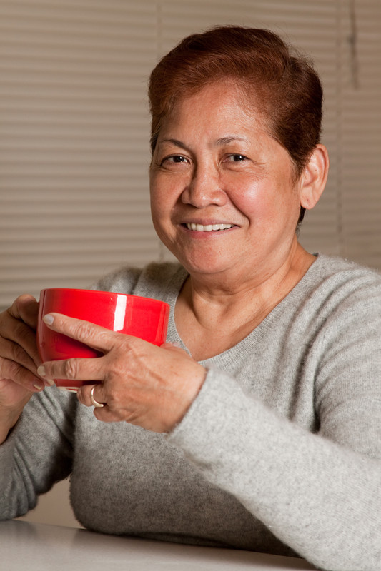
Eva’s Story
In your groups, read through Eva’s story.
Given the limited information we have about this client and her situation, select the answer that your group can justify as being the best answer for Question 1. Then scratch off that answer's feedback.
If that answer is not the best answer, discuss with your group what the next best choice may be. Continue until your group uncovers the answer considered to be the best answer based on information from the eLearning.
Once you’ve uncovered the best answer, give points for the question.
The point system is on Handout #2- Eva’s Story Scorecard
Continue with the rest of the questions using the same system.

Slide 11
Who Takes the Lead?
How many points did each team get?

Slide 12
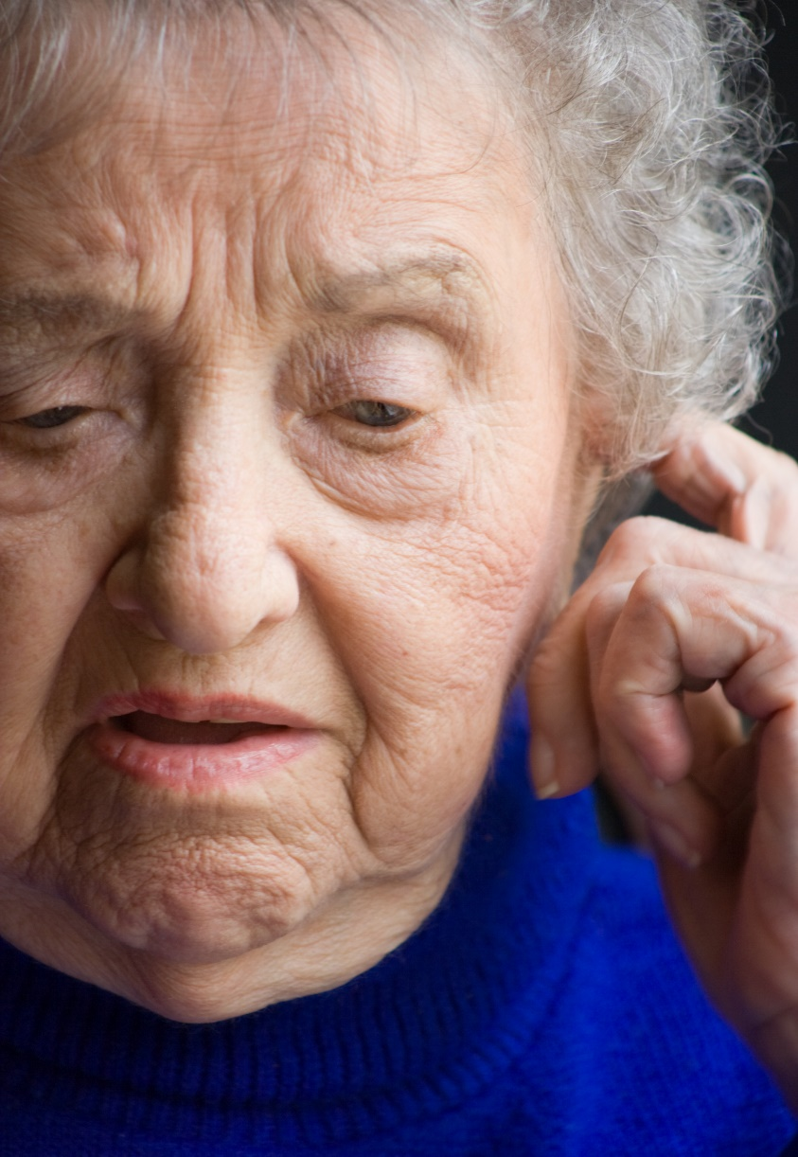
Case Pre-Planning Activity
Read through Handout #3-Mildred Jackson
As a group, identify the factors of Mildred’s case in each of the six areas listed.
Groups will have to list their guesses based on the limited scenario information provided.
Write your considerations for each area on flip chart paper as provided.
Select one person to report out on your answers.

Slide 13
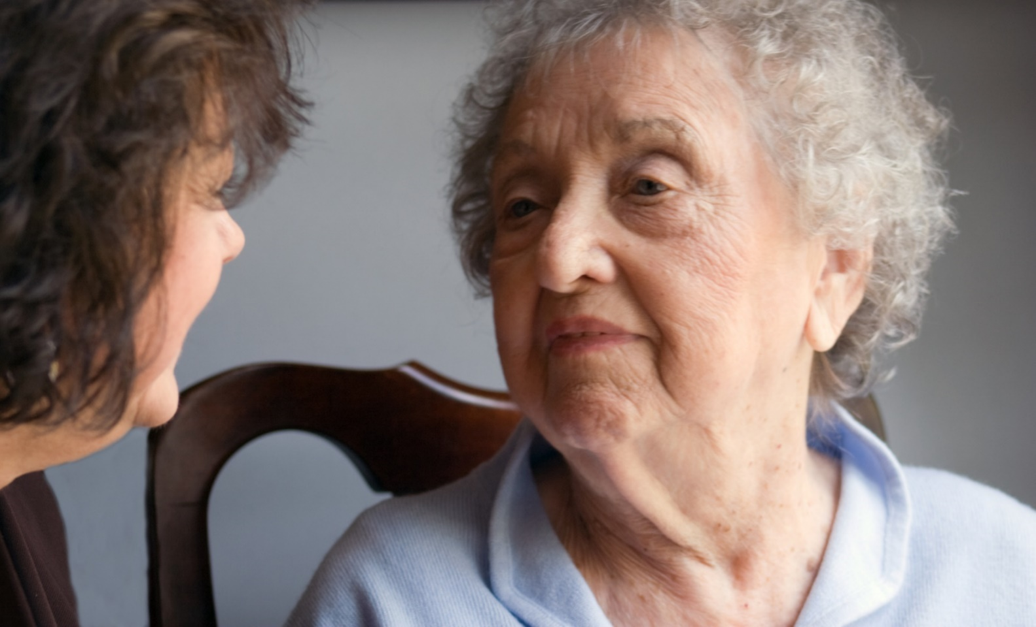
Interview Questions
Read the Interview Questions
Discuss the statements provided
Decide which multiple choice answer is the best answer.
Vote using corresponding letter on your voting card.
A
B
C

Slide 14
In terms of assessing for Mildred’s wishes, which of the following questions might be the best to ask her in this situation?
What would you wish for that could make your situation better?
Would you rather live somewhere else?
Is there a reason that only your adopted daughter lives with you?
Do you like living here with Emma?
Your team gets 2 points for a correct answer

Slide 15
In assessing for alleged abuser issues, which question might be the best to use when assessing for any abuser issues regarding Mildred’s case?
Is there anything or anyone that makes you afraid or uncomfortable?
Does Emma behave differently than your other children toward you?
Is Emma having mental health problems?
Has anyone been threatening you?
Your team gets 2 points for a correct answer

Slide 16
In assessing for any urgency related to risk factors what might be the best question to ask Mildred when you first meet her?
Are you scared when Emma comes home?
If you are feeling anxious or afraid, are there any reasons that you are more afraid now?
If I told you that physical abuse and financial abuse are very common in our society, would you be surprised?
Has Emma been violent?
Your team gets 2 points for a correct answer

Slide 17
In terms of ethical considerations, what might be the best question to ask Mildred when you first speak to her?
Do you think you might be happier living somewhere else?
Do you know that your children are worried about you?
Are you happy with your living situation?
Are you taking care of Emma or is she taking care of you?
Your team gets 2 points for a correct answer

Slide 18
What would the best question be to begin assessing Mildred’s cultural considerations?
When you grew up, was family life very different than your life with your family is now?
In the family you grew up in, were family members who were physically or mentally ill cared for at home?
What kind of food and drink did you grow up with?
Were your parents immigrants?
Your team gets 2 points for a correct answer

Slide 19
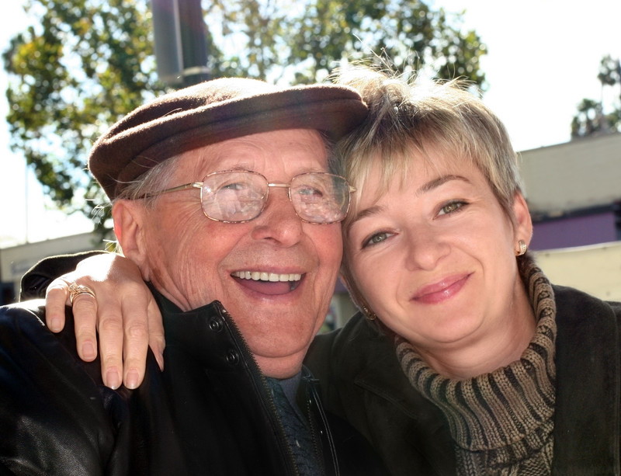
Reframing (Strength Focused) Activity
Read the Reframing Situations Questions
Discuss the statements provided
Decide which multiple choice answer is the best answer.
A
B
C

Slide 20
“She knows how to work the system. She manipulates one agency against the other.”
She is a long-term client and has learned to ‘play the game’ effectively.
She is a system and agency abuser
She has a long history of working with various agencies and interacts with each in a way that best suits her needs.
She may have Dissociative Identity Disorder and becomes different people when she contacts different agencies.
Your team gets 2 points for a correct answer

Slide 21
“She needs so much care but is so resistant to anything I offer. She doesn’t want a home health aide. She doesn’t want a nursing home. She just wants to be left alone.”
She is very independent and wants to live on her own in her own home.
She is incapable of understanding her own needs and in denial about her need for help.
She is an anti-social type of person who always pushes people away.
She knows what she wants and who am I to try and convince her otherwise?
Your team gets 2 points for a correct answer

Slide 22
“She and that no good son of hers can’t survive without each other. Their codependency is so destructive.”
She loves her son and takes care of him like a good mother should.
She has made her son very dependent on her.
She and her son would be better off if they each lived separately
She and her son are very close and are hesitant to make decisions without consulting one another.
Your team gets 2 points for a correct answer

Slide 23
“I just can’t get her to move on any suggestion. She is so passive about the horrible situation she is in. It is so frustrating.”
She is highly ambivalent about making any changes to her situation and is resolved to deflect my suggestions until she is ready to change.
She is socially isolated and unmotivated to take care of herself.
She is defiant in the face of authority, but won’t take actions on her own.
Eventually her environment will get worse and she will need conservatorship.
Your team gets 2 points for a correct answer

Slide 24
“Anyone who chooses to stay in such an abusive situation is using poor judgment. It is time to determine if he can make these decisions for himself.”
He must like the abuse to stay in that situation.
He seems reluctant to leave the situation although it places him at risk of abuse.
Due to undue influence, he is unable to choose to leave the situation.
He comes from a family history of abuse so his script is already written and it makes sense that he is either a victim or an abuser himself.
Your team gets 2 points for a correct answer

Slide 25
What’s Out There
Note the 5 flip chart sheets on the wall for each category of services.
As teams (identified by marker color), add resources to each category.
You can use:
The ‘Scavenger Hunt’ activity handout that you filled out after you completed the Voluntary Case Planning eLearning
Resource Directories if available.
Your smart phone or tablet.
Bonus points for websites and/or phone #s to accompany resource
Your team scores one point for each unique resource (no duplicates) and one point each for website and/or phone #

Slide 26
Finding Resources
Which group had the most entries on the 5 sheets?
Why did your group select the resources that you decided to list?
Do you see any gaps in resources for some client needs that often come up?

Slide 27
Evaluating the Case Plan
Remember these considerations that you learned about in the Voluntary Case Planning eLearning:
Hidden/unintended consequences
Ethical Dilemmas
Workability of the plan
Whose needs are being served
Plan B

Slide 28
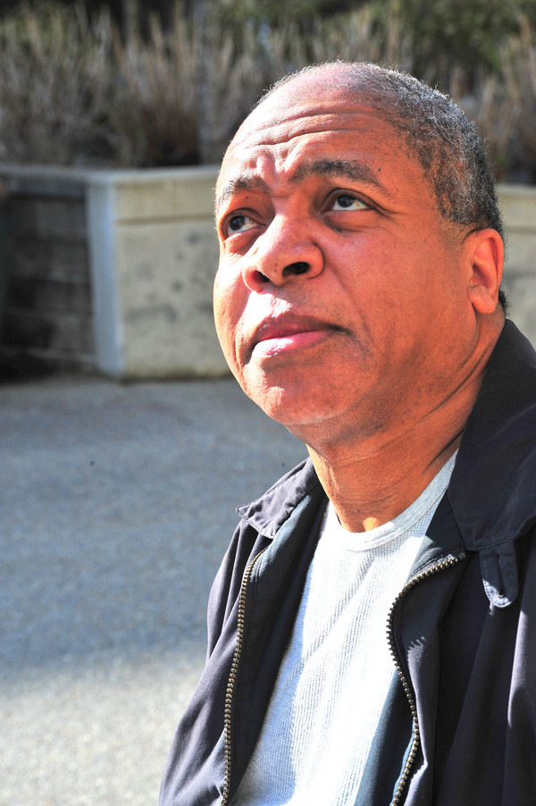
Evaluating the Joe Jones’ Case Plan
Read through the scenario for Joe Jones
Discuss Joe’s scenario as a group
Decide on your group’s answers to all the questions pertaining to Joe’s situation and case planning for Joe
A
B
C

Slide 29
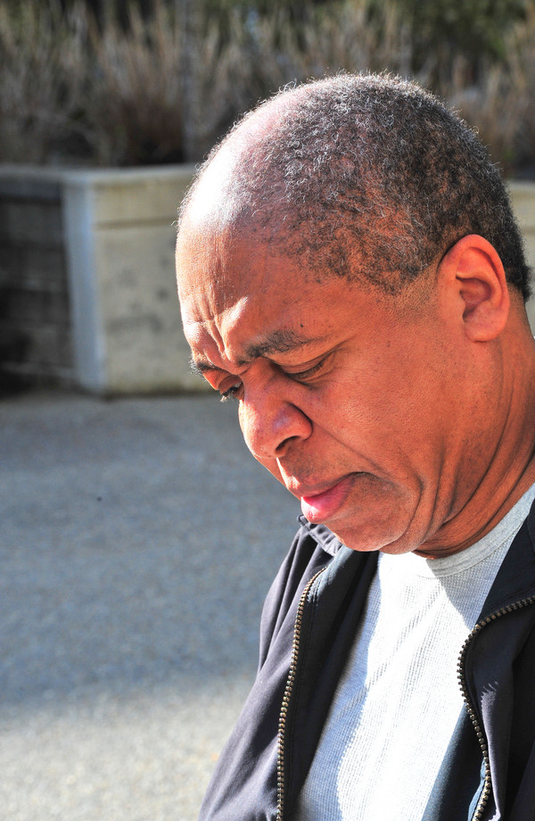
Joe’s Case Plan
You get two points if your answer is “the best answer”
Can you make a case for your answer?
You can have 2 minutes to make your case.
Class can vote to award a point or not.

Slide 30
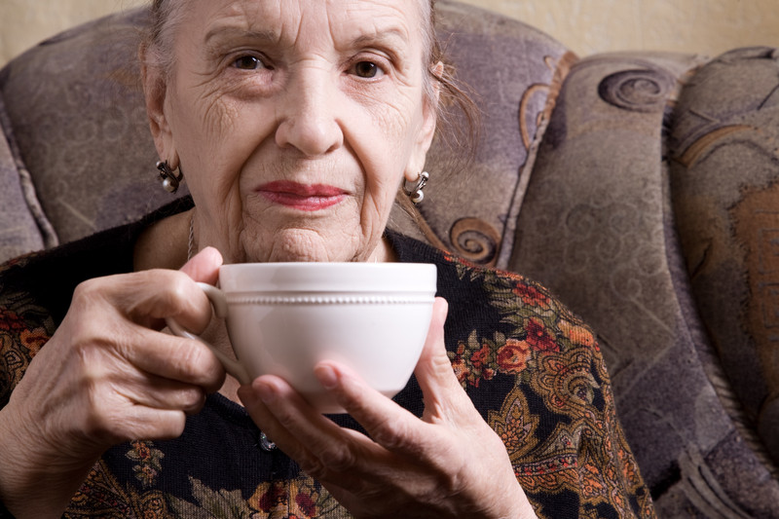
Safety Planning
Safety Planning Includes:
Risk Reduction Strategies
Protection Strategies
Notification Strategies
Referral/Services
Emotional Support

Slide 31
Safety Planning Pitfalls
Telling the Victim what to do
Helping the victim accomplish your goals
Simply referring victim to local agencies
Ignoring cultural, spiritual or generational values
Recommending strategies that increase risk
Blaming the victim

Slide 32
Safety Planning Tool
Safety Planning Packet
Victim Centered Safety Planning
Safety Planning Tips
Checklist for Leaving
Guiding Principals
Safety Planning Steps

Slide 33
Safety Planning for Irene
Each group needs:
Irene
Recorder
Primary interviewer
Secondary interviewers
Moderator to keep the safety planning on tracker

Slide 34
Safety Plan for Irene – Round One
“Irene” play actor to read card #1 and act accordingly
Discuss safety planning for Irene as a group
What was your case plan for Irene?
Does your safety plan address Irene’s concerns? Do Irene’s desires reflect safe options? What compromises did you need to make?
What if something changes…?

Slide 35
Safety Plan for Irene – Round Two
Irene’s husband passed away unexpectedly
Irene’s son is drinking more and has become aggressive.
Based on what Irene wants, develop a new safety plan.

Slide 36
Safety Plan for Irene – Round Three
Irene’s son has gotten a job and is drinking less.
Irene is lonely
Based on what Irene wants, develop a new plan.

Slide 37
Safety Plan for Irene - Conclusion
How did your group’s safety plan (based on the scenario and its changes) work?
What issues did your group have?
What concerns do you still have?
What was the purpose of the plan that your group proposed?

Slide 38
A Moment to Reflect
Questions?
Lessons Learned….

Slide 39
Evaluations & Thank You
Thank you for attending this course and for the important work you do every day protecting older and vulnerable adults in your community!
Please complete the course evaluation.
Subscribe to the Academy’s email newsletter to receive training news & updates.
Let’s connect:
@SDSUAcademy
@Acad4ProfExcell
@sdsu-academy-for-professional-excellence/
@TheAcademySDSU

Slide 40
We envision a world where the quality of life for individuals, organizations, and communities is transformed to a healthier place.

