Slide 1
The APS Supervisor as Trainer Preparing New APS Professionals for the Field

Slide 2
About APSWI & The Academy
Adult Protective Services Workforce Innovations (APSWI)
Training program of the Academy for Professional Excellence, a project of the San Diego State University School of Social Work.
The Academy provides workforce development and learning experiences to health and human service professionals. Programs include:

Slide 3
Housekeeping
Location of restrooms
Set cell phones to vibrate
Please return promptly from breaks and help us keep to the schedule
Materials
PowerPoint Slides
Participant Materials

Slide 4
Introductions
Trainer
Activity #1-Hide and Seek

Slide 5
Learning Objectives
1
Gain an understanding of the basic tenets of Kolb’s Experiential Learning Theory and articulate the responsibility of the supervisor in promoting effective adult learning when training new APS professionals.

Slide 6
Learning Objectives
2
Learn how to implement training techniques such as asking open-ended questions, with the goal of developing critical thinking skills amongst staff

Slide 7
Learning Objectives
Learn how to utilize two established tools that can be applied in order to evaluate a new APS professional’s integration of the training materials
3

Slide 8
Learning Objectives
4
Practice providing supportive, critical feedback so that they may acquire skills enabling them to effectively reflect on staff’s performance when conducting training

Slide 9
Course Goals
After attending today’s training, participants will:
Be able to assess new staff’s learning style enabling themselves to provide appropriate and targeted training
Correctly apply at least one new training strategy in order to reinforce the NAPSA Core Competency skills

Slide 10
Road Map

Slide 11
Super Hero
Super Power

Slide 12
Frontline Supervisor: A Multi-faceted Role
Clinical Supervision
Managing Personnel Issues
Community Representation
Back-up Coverage to staff
Ensuring Compliance
Role Modeling

Slide 13
Parallel Processes
More is ‘caught’
than ‘taught’ by the supervisor

Slide 14
Frontline Supervisor: A Multi-faceted Role (continued)
And…
training new and veteran staff!

Slide 15
Supervisor Competencies
Professional Use of Self
Foundations of APS Work: Common Knowledge and Skills
APS Casework Methods and Practice
Supervisor as Manager
Supervisor as Leader
Supervision and Development of Staff

Slide 16
Training
Complete self-analysis

Slide 17
Topics You Train?

Slide 18
Challenges
Insufficient Time
Lack of experience/expertise with training
Lack of training related resources or budget
Lack of a standardized/established curriculum
Lack of an overall training plan
Limited evaluation techniques

Slide 19
What do Training Programs Look Like?
Structured Non-Structured
Strict Timeline No Timeline
Supervisor as Trainer Peer-to Peer Training
Established Curriculum Eclectic Approach
VS

Slide 20
APS Training Programs Nationwide
What are you doing?
What are other APS programs across the Nation doing?

Slide 21
Conducive Learning Environment
Student is highly motivated
Student devotes energy to learning
Learning atmosphere is supportive and rewarding
Content is presented in a meaningful way
Supervisor takes into consideration uniqueness of each learner

Slide 22
Adult Learning Theory-101
Unconscious
Incompetent
Conscious
Competent
Conscious
Incompetent
Unconscious
Competent

Slide 23
Adult Learning Theory Example
I hear and I forget
I see and I remember
I do and I understand
Buddhist quote

Slide 24
Barriers to Adult Learning
Fear of making mistakes
Non-relevant materials
Lack of participation
Fear of change
Formal atmosphere

Slide 25
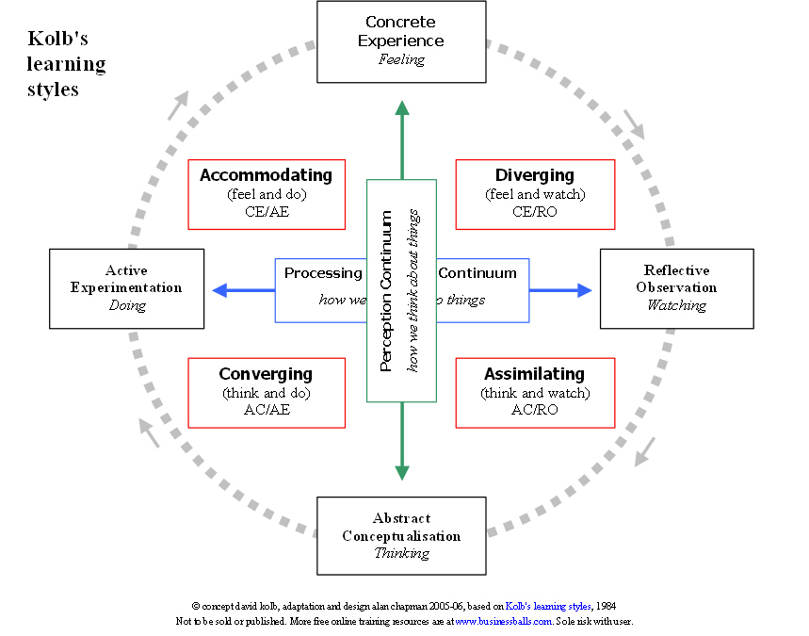
Kolb’s Learning Styles

Slide 26
Characteristics of Each Style
Accommodating -
Getting Things Done
Leading
Taking Risks
Initiating
Being Adaptable
Being Practical
Diverging -
Being Imaginative
Understanding People
Recognizing Problems,
Brainstorming
Being open-minded
Converging -
Solving problems
Making Decisions
Reasoning
Defining Problems
Being Logical
Assimilating -
Planning
Creating Models
Defining Problems
Developing Theories
Being Patient

Slide 27
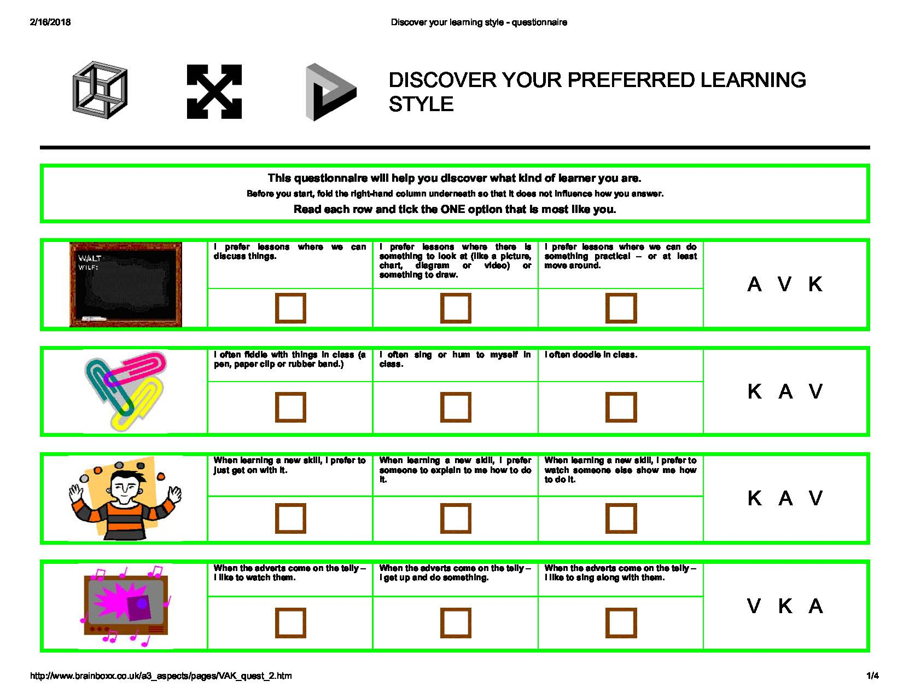
What Kind of a Learner are You?

Slide 28
What Kind of a Trainer are You?

Slide 29
APS Training Modalities
What teaching tools do you have?

Slide 30
Matching Staff’s Learning Style with a Training Method
Case Studies
Videos
Written Information
Brainstorming
Critical Incidents
Games
Shadowing

Slide 31
What Should We Teach New APS Professionals?
Standardized Training contributes to:
Adherence to policy
Consistence
Improved Outcomes
Reduced Liability

Slide 32
NAPSA Core Competencies
23
www.napsa-now.org

Slide 33
APS Core Competencies Modules
1. APS Overview
2. APS Values and Ethics
3. Agency Standards and Procedures
4. The Aging Process
5. Physical & Developmental Disabilities
6. Mental Health Issues
7. Substance Abuse
8. Dynamics of Abusive Relationships
9. Professional Communication
10. Self-Neglect
11. Caregiver Neglect
12. Financial Exploitation
13. Physical Abuse
14. Sexual Abuse
15. Case Documentation/Report Writing
16. Intake Process
17. Investigation: Client Capacity
18. Investigation: Risk Assessment
19. Voluntary Case Planning & Intervention
20. Involuntary Case Planning & Intervention
21. Collaboration & Resources
22. Legal Issues & Law Enforcement
23. Case Closure

Slide 34
Critical Thinking Skills

Slide 35
Teaching Critical Thinking Skills
Modeling
Focus on Process
Look for Themes

Slide 36
Has Your Staff Learned the Material?
Application to job?
Impact on client outcomes?
Use of Standardized Evaluation Tools
Transfer of Learning
Exercises
WISE Tool

Slide 37
WISE (Worker Interview Skills Evaluation)*
Assesses investigative/interview skills
Direct observation
9 Item Scale
Rating on scale of 1-5
Self-assessment
Supervisor may use periodically
*Materials provided by Texas Department of Family and Protective Services, Adult Protective Services Program and Training Division. Permission granted for use 2010 NAPSA Conference.

Slide 38
Evaluating APS Trainees

Slide 39
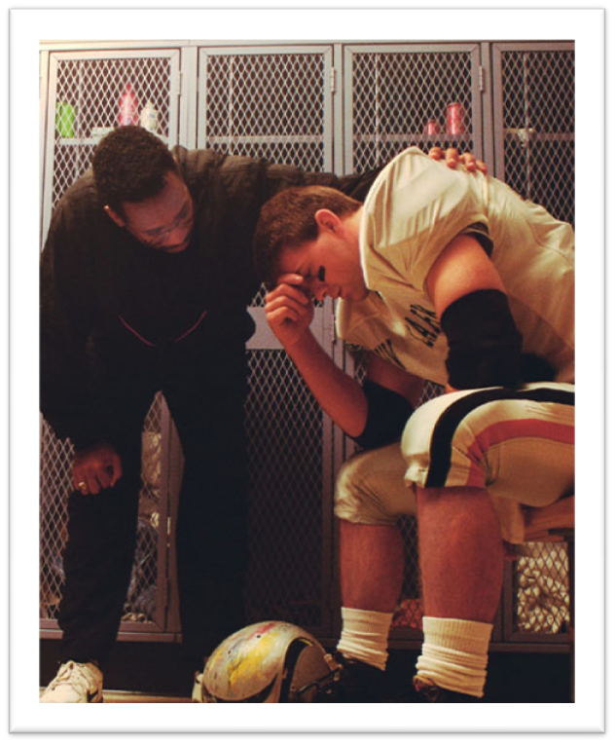
Coaching vs. Bossing

Slide 40
Elements of an Effective Critique
Inquiry
Generalization
Data
Theory
Demonstration

Slide 41
Putting it Into Practice

Slide 42
30-Day Guarantee
Guaranteed
1-3 ideas or plans from today’s training that you feel you could “guarantee” to realistically implement within the next 30 days.
Extended Warranty
1-3 ideas or plans from today’s training that might take six months or more to achieve

Slide 43
Evaluations & Thank You
Thank you for attending this course and for the important work you do every day protecting older and vulnerable adults in your community!
Please complete the course evaluation.
Subscribe to the Academy’s email newsletter to receive training news & updates.
Let’s connect:
@sdsu-academy-for-professional-excellence/
@TheAcademySDSU
@Acad4ProfExcell

