Slide 1

Overview of APS:
In-person Training
Adult Protective Services Core Competencies - Module 1
Developed by Krista Brown from Overview of APS eLearning by Lisa Nerenberg, Lori Delagrammatikas and Val Ryan.

Slide 2
How We Got Here
APS Training Project
Goal: Statewide Standardized Core Curriculum for new APS/IHSS social workers
Partners in this effort
Impact of project:
National APS Training Partnership
  California
  National - NAPSA

Slide 3

Housekeeping and Introductions
Schedule for the day
Location of restroom
Set cell phones to vibrate
Introductions
Notes:
Professional Communication
3

Slide 4
Evaluation Process
All APS Training has 3 evaluation components:
Transfer of Learning Activity
Pre-post knowledge assessment
Satisfaction Survey

Slide 5
Developing an ID Code
S | M | I | A | L | I | 2 | 9
What are the first three letters of your mother’s maiden name? (Alice Smith)
What are the first three letters of your mother’s First name? (Alice Smith)
What are the numerals for the DAY you were born? (Nov 29th)
Trainee ID Code

Slide 6
Learning Objectives
Describe APS Clients.
Explain APS worker’s roles and responsibilities under their state mandates.
Evaluate simple APS referrals.
Develop a basic case plan.
Apply key terminology used in APS.

Slide 7

History of aps
Title XX of the Social Security Act
Enacted in 1975
Permitted states to use funds, known today as Social Services Block Grants (SSBG), for advocacy and services to:
Adults who, “as a result of physical or mental limitations, are unable to act in their own behalf; are seriously limited in the management of their affairs; are neglected or exploited; or are living in unsafe or hazardous conditions.“

Slide 8

Congressional hearings prompted states to enact reporting laws.
National Center on Elder Abuse
http://www.ncea.aoa.gov/
Notes:
Audio Narration:
But then, in the late 1970s and early 1980s, Congress again got involved. Under the leadership of advocates like Claude Pepper, Congress held hearings on elder abuse around the country and encouraged states to address the problem.
Most states charged their APS programs to take the lead in investigating reports of abuse and neglect. They enacted laws that were very similar to those they’d enacted years earlier to combat child abuse.
Because each state has its own laws, APS programs vary across the states. Workers need to learn their own states’ laws as far as who’s covered, the kinds of abuse that must be reported and what the penalties are for failure to report.
For more information about how state laws differ, go to the National Center on Elder Abuse’s Analysis of State Adult Protective Services Laws - http://www.ncea.aoa.gov/.

Slide 9

Practice Principles
Adults have the right to be safe.
Adults retain all their civil and constitutional rights unless some of these rights have been restricted by court action.
Adults have the right to make decisions that do not conform with societal norms as long as these decisions do not harm others.
Adults are presumed to have decision-making capacity unless a court adjudicates otherwise.
Adults have the right to accept or refuse services.
From NAPSA (APS) Code of Ethics http://www.napsa-now.org/about-napsa/code-of-ethics/

Slide 10
Aps clients’ service Goals
Maximize independence
Strengthen care giving systems
Resolve crises
Ensure safety
Empower and support victims
Preserve, protect and recover assets
Ensure justice
Provide resources to treat the physical, financial and emotional effects of abuse
Ensure that elders who are unable to make critical decisions have trustworthy surrogates
Reduce the risk of abuse and neglect
Hold perpetrators accountable
Notes:
Audio Narration
Following these principles, APS workers seek to achieve multiple goals:
Maximize independence
Strengthen care giving systems
Resolve crises
Ensure safety
Empower and support victims
Preserve, protect and recover assets
Ensure justice
Provide resources to treat the physical, financial and emotional effects of abuse
Ensure that elders who are unable to make critical decisions have trustworthy surrogates
Reduce the risk of abuse and neglect
Hold perpetrators accountable

Slide 11

victims
More likely to:
Be women
Have physical and/or cognitive impairments
Live with others
Have suffered recent losses
Have low social support
National Center on Elder Abuse, 2004; Ernst, Ramsey-Klawsnik, Schillerstrom, Dayton, Mixson, & Counihan, 2014; Lachs & Pillemer, 2004; Quinn, 2002; Acierno, Hernandez-Tejada, Muzzy, & Steve, 2009

Slide 12



abusers
Family members
Friends and acquaintances
Professionals
Corporations and business entities
Perpetrators of abuse in long term care facilities may include employees, other residents or visitors
Naughton et al, 2012; National Center on Elder Abuse, 2004

Slide 13

Causes or motives of abuse or neglect
Financial gain
Malevolence
Mental health problems
Caregiver issues
Power and control
Notes:
Audio Narration:
Financial gain is emerging as one of the most common motives for abuse, and that isn’t just limited to cases of financial abuse. Caregivers may withhold food or care to coerce someone into turning over money or property. In some cases a caregiver who stands to inherit may want to hasten the person’s death.
Sometimes abuse is grounded in old resentments. It may be retaliatory.
Perpetrators with mental illnesses may not be able to control their behavior. They may become violent because of delusions or paranoia. Perpetrators with drug problems may also lash out in violence, or they may steal from elders to support their habits.
Caregivers may lack the skills or training that’s needed to provide good care. They may be exhausted or under extreme stress. Abuse is more likely when caregivers and care receivers had bad relationships in the past, prior to the onset of disability.
Abuse by intimate partners may stem from the drive for power and control.

Slide 14

Aps’ state mandate (california)
Under California’s Welfare Institution and Code, APS is charged to investigate and respond to allegations of abuse, neglect and exploitation against elders and dependent adults who live in the community when these adults are unable to meet their own needs, or are victims of abuse, neglect or exploitation.

Slide 15


Aps client definitions (california)
Elders
Dependent Adults
Notes:
Audio Narration:
Here in California, APS workers serve elders and dependent adults. Click on the pictures to see how elders and dependent adults are defined.

Slide 16

Aps client definitions (california)
Elders
Elders are persons residing in this state who are 65 years of age or older (WIC Section 15610.27).

Slide 17
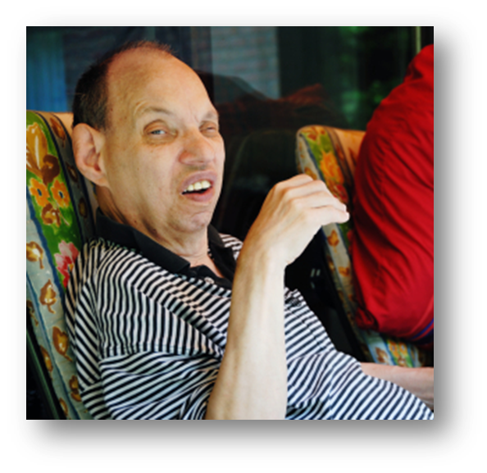
Aps client definitions (california)
Dependent Adults
Dependent Adults are persons between the ages of 18 and 64, who have physical or mental limitations that restrict their ability to carry out normal activities or protect their rights including, but not limited to, persons who have physical or developmental disabilities or whose physical or mental abilities have diminished because of age (WIC Section 15610.23).
Notes:
Audio Narration:
Dependent adults are persons between the ages of 18 and 64, who have physical or mental limitations that restrict their ability to carry out normal activities or protect their rights including, but not limited to, persons who have physical or developmental disabilities or whose physical or mental abilities have diminished because of age.

Slide 18

A closer look at disability
Physical or mental impairments that substantially limit daily activities. May be caused by:
Chronic diseases
Mental illnesses
Dementias
Developmental disabilities
Accidents

Slide 19
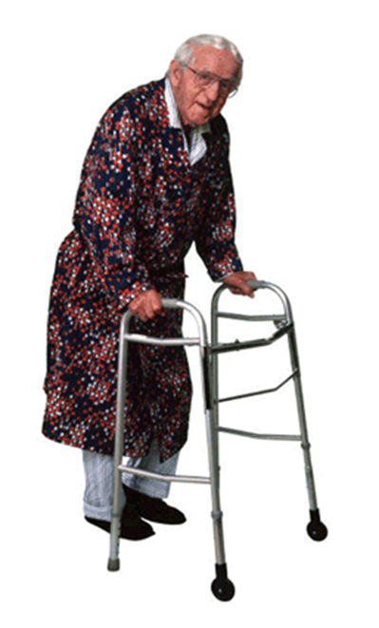
Factors affecting disability & dependence
Age at the onset of disability
Coping ability
Social and emotional support
Financial resources
Attitude/acceptance
Culture
Environment

Slide 20
Vulnerability
People with disabilities may be “at risk” (vulnerable) for:
Premature decline
Mental health problems, including depression, substance abuse and suicide
Falls or other injuries
Self-neglect
Abuse and neglect by others
Notes:
Audio Narration:
Adults with impairments who depend on others for help MAY be at risk for the problems listed here. “At risk” means that they are more likely to experience these problems than those who don’t have impairments.

Slide 21
caregivers
Definition
Provide ongoing to care to people with disabilities
Providers
Most care provided by family members, with women providing majority of care
Tasks
Variety of tasks including balancing checkbooks, grocery shopping, cooking, giving medications, assisting with bathing or dressing, etc.
Laws
- The “duty to care” may be imposed by law (through contract or family relationship)
Most are unpaid. Payment can come from client, 3rd party, MediCal

Slide 22
Reliance on caregivers may heighten risk
Imbalance in power
Shortage of caregivers and inadequate screening
Caregivers are likely to have access to adults’ homes, finances and personal information
Depending on the nature of the adults’ disabilities, they may be less able to:
    Understand or appreciate financial transactions, proposals or threats
    Avoid, escape or flee from danger
    Withstand manipulation, pressure, coercion or threats

Slide 23
Responding to abuse reports
Under California’s elder adult reporting law, certain individuals must report the following types of abuse committed against elders and dependent adults to APS (WIC Section 15610.07):
Physical Abuse
Psychological Abuse
Financial Abuse
Abduction
Abandonment
Isolation
Neglect

Slide 24
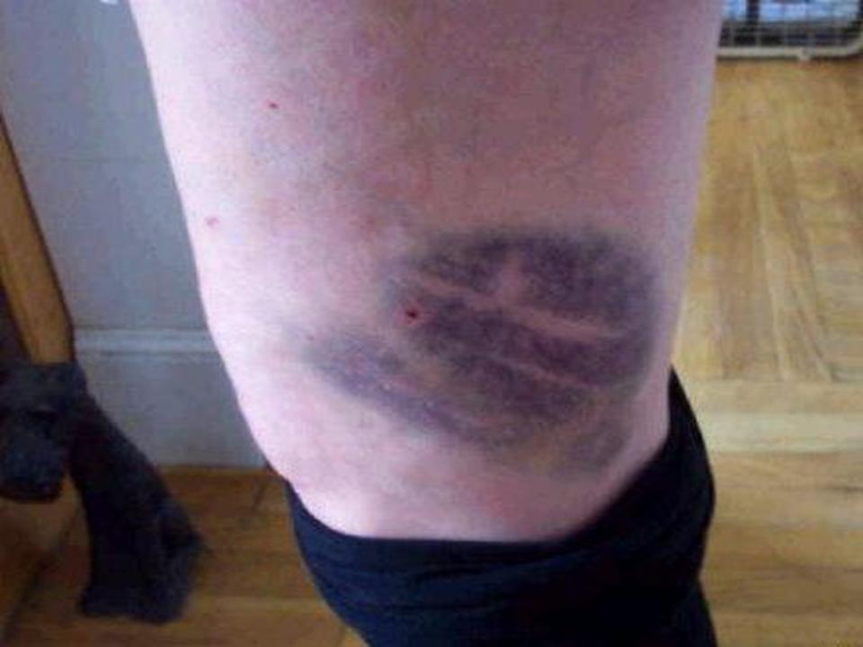
Physical abuse (California)
Includes:
assault, battery, assault with a deadly weapon, unreasonable physical constraint, prolonged or continual deprivation of food or water, sexual assault and rape (WIC Section 15610.63).

Slide 25

Psychological abuse (California)
Psychological or mental abuse is causing:
Fear
Agitation
Confusion
Severe depression
Emotional distress
(WIC Section 15610.53)

Slide 26

Financial abuse (California)
Taking, secreting or appropriating money or property of an elder or dependent adult by a person who has the care or custody of or who is in a position of trust to, that elder or dependent adult (WIC Section 15610.30).

Slide 27

Abduction (California)
Removal from state and/or restraint from returning to this state of any elder or dependent adult who does not have the capacity to consent to the removal from or restraint from returning to this state (WIC Section 15610.06)

Slide 28

Abandonment (California)
Desertion or willful forsaking of an elder or a dependent adult by anyone who has care or custody of that person under circumstances in which a reasonable person would continue to provide care and custody (WIC Section 15610.05).

Slide 29

Isolation (California)
Isolation means prevention from receiving phone calls or mail, false imprisonment or physical restraint from meeting with visitors (WIC Section 15610.43).

Slide 30
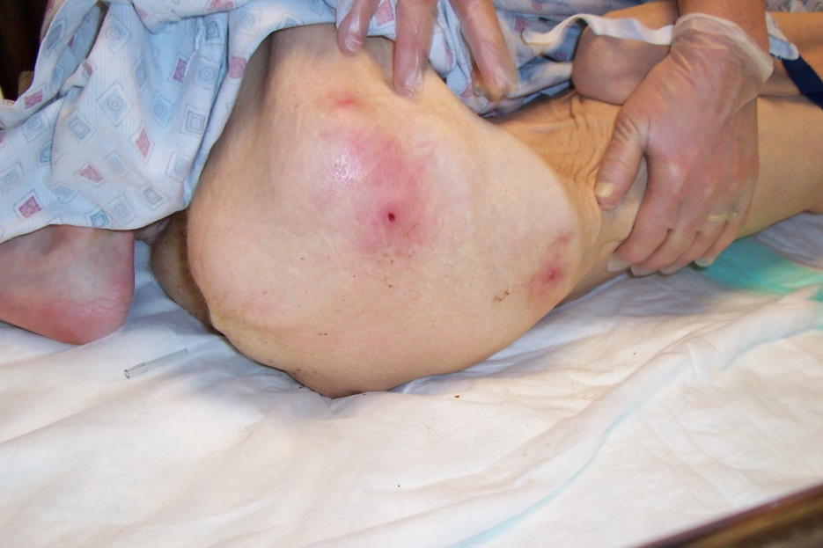
neglect (California)
“Negligent failure” to:
Assist with personal hygiene
Provide food, clothing, shelter or medical care
Protect from health and safety hazards
Prevent malnutrition or dehydration
(WIC Section15610.57)

Slide 31

Self-Neglect (California)
The negligent failure of an elder or dependent adult to exercise that degree of self care that a reasonable person in a like position would exercise.
(WIC Section15610.57)

Slide 32
Indicators of abuse
Actual signs, symptoms or evidence. They include:
Suspicious injuries, including bruises or fractures, or burns that are not likely to occur accidentally.
Suspicious documents, such as recently executed wills, deeds or trusts executed by elders with severe impairments.
Suspicious behaviors such as elders and their caregivers offering different explanations for injuries.

Slide 33
Videos
Physical Abuse
Psychological
Abuse
Financial Abuse

Slide 34
Abuse Type as a Percentage of All Reports (CA)
*There were 91 cases of confirmed/inconclusive sexual abuse

Slide 35
Who is required to report?
In California: “Any person who has assumed full or intermittent responsibility for care or custody of an elder or dependent adult, whether or not that person receives compensation, including administrators, supervisors and any licensed staff of a public or private facility that provides care or services for elder or dependent adults, or any elder or dependent adult care custodian, health practitioner, clergy member or employee of a county adult protective services agency or a local law enforcement agency, is a mandated reporter.” (WIC Section 15610.17)
Notes:
Audio Narration:
In California, “Any person who has assumed full or intermittent responsibility for care or custody of an elder or dependent adult, whether or not that person receives compensation, including administrators, supervisors, and any licensed staff of a public or private facility that provides care or services for elder or dependent adults, or any elder or dependent adult care custodian, health practitioner, clergy member, or employee of a county adult protective services agency or a local law enforcement agency, is a mandated reporter.”

Slide 36
Which of the following individuals are mandated reporters? Why?
Paramedic
Neighbor
Daughter providing volunteer respite care
Adult Day Health
Doctor
Priest
Banker
Public
Notary

Slide 37
Responding to Abuse – Jurisdiction (California)
If the abuse occurred in: | Then the report goes to:
Private homes
Long Term Care Facility
State Mental Health Hospital
State Developmental Center
Penal code violations in any setting
APS
Ombudsman
State Dept. of Mental Health
State Dept. of Developmental Services
Law Enforcement

Slide 38
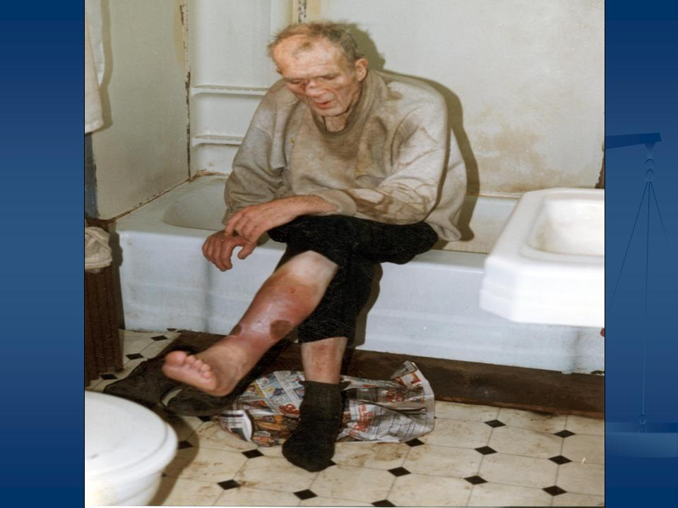
Aps Services are voluntary
Exceptions:
When adults are incapable of consenting as a result of impairment (acting under the principle of parens patriae)
When crimes have been committed

Slide 39
Who is eligible for aps services?
Based on what you have learned so far, please read each of the following case vignettes and determine whether or not it is an appropriate APS referral.
This is an APS Case
I need more information
This is NOT an APS Case

Slide 40
Goals of aps practice (California)
Determine if vulnerable adults’ basic needs are being met.
Determine if abuse, neglect or exploitation have occurred or are likely to occur.
Provide or arrange for services to reduce vulnerability, stop misconduct that is occurring and treat the effects.
Hold perpetrators accountable.

Slide 41
Determining if vulnerable adults’ basic needs are being met
APS workers typically make home visits to determine how vulnerable elders are managing. They may use functional assessment tools:
Activities of Daily Living (ADL) Scales
Instrumental Activities of Daily Living (IADL) Scales

Slide 42
Capacity assessments
May be needed to:
Determine if abuse has occurred
Determine what interventions are available and appropriate
Several simple screening tools are available to help detect problems. Examples include:
The Montreal Cognitive Assessment (MoCA©)
Clock Drawing Test/Mini Cog Assessment
Trail Making Test

Slide 43
Principles of capacity assessment
Capacity is specific to the task at hand. Various tasks and decisions required different types and levels of capacity.
Does your client understand their situation?
Does your client understand the risks of their behavior?
Does your client understand the benefits of accepting help?

Slide 44

Does your client understand their situation?
Your assessment of whether the client has the mental facility to understand the elements of their situation as well as the risks and benefits will determine whether you can walk away if they refuse services or whether you need to refer the client for a full geriatric assessment.

Slide 45

Does your client understand the risks of their behavior?
People of all ages have the right to make poor decisions and engage in risky behaviors. However, you need to determine whether your client understands the risk.

Slide 46

Does your client understand the benefits of accepting help?
You will also need to assess whether your client is able to understand the benefits of accepting help. Sometimes clients are able to articulate the risks of their behavior but they can’t image those small changes that would minimize those risks and allow them to stay somewhat safely in their own home.

Slide 47
Principles Guiding Practice
Factors for Case Planning
Client capacity to consent
Client perception of the problem
Client wishes and motivation
Client formal/informal supports
Worker perception of problem & level of threat
Services that client is eligible for/available

Slide 48

Case study Activity
Read the case study about Mr. Adams and decide how you might proceed.

Slide 49
Closing
Optional Pre-Test
Q & A
Evaluations
Thank you for your time and energy!!!
Notes:
Correct optional pre-test

