Slide 1
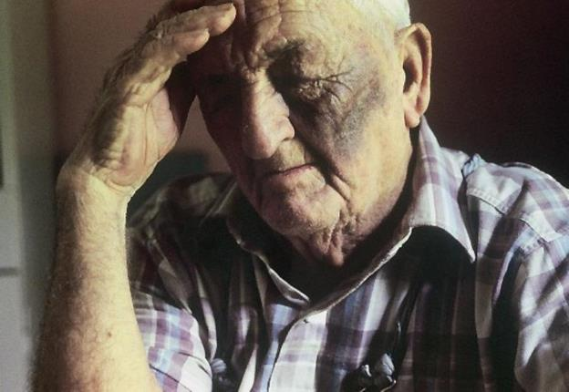
National Adult Protective Services Association
Notes:
1

Slide 2
DYNAMICS OF ELDER ABUSE
Kathleen Quinn
Phone: 202-558-4850
Email: kathleen.quinn@apsnetwork.org
Notes:
2

Slide 3
A Project of
NAPSA and NCALL
National Adult Protective Services Association
National Clearinghouse on Abuse in Later Life
Funded by the Office of Violence Against Women,
U.S. Department of Justice
U.S. Department of Justice
Module 8A Dynamics of Elder Abuse
Notes:
3
3

Slide 4
National Adult Protective Services Association
NAPSA is the only national organization which represents APS professionals, programs and clients
NAPSA is the national voice of APS
NAPSA is a partner in the National Center on Elder Abuse
NAPSA has members in 49 states and DC
Module 8A Dynamics of Elder Abuse
Notes:
4

Slide 5
APS CORE COMPETENCIES
HANDOUT #1: APS COMPETENCIES
NAPSA has identified 23 core competencies for APS; each will have a training module.
Dynamics of Elder Abuse, is Module #8A
Module 8A is about ELDER ABUSE
and not about abuse of younger adults with disabilities.
Other modules cover other topics in depth.
Module 8A Dynamics of Elder Abuse
5
Notes:
5
5

Slide 6
APS CORE COMPETENCIES
1. APS Overview
2. APS Values and Ethics
3. Agency Standards and Procedures
4. The Aging Process (available for a fee)
5. Physical and Developmental Disabilities
6. Mental Health Issues
7. Substance Abuse
8. Dynamics of Abuse: A) Elder B) Younger Adults
9. Professional Communications
10. Self Neglect
11. Caregiver Neglect
Module 8A Dynamics of Elder Abuse
Notes:
6

Slide 7
APS CORE COMPETENCIES
12. Financial Exploitation
13. Physical Abuse
14. Sexual Abuse
15. Case Documentation/Report Writing
16. Intake Process
17. Investigation: Client Capacity
18. Investigation: Risk Assessment
19. Voluntary Case Planning and Intervention
20. Involuntary Case Planning and Intervention
21. Collaboration and Resources
22. Legal Issues and Law Enforcement
23. Case Closure
Module 8A Dynamics of Elder Abuse
Notes:
7

Slide 8
TODAY'S TRAINING GOAL
To enable Adult Protective Services (APS) professionals to understand the dynamics of elder abuse perpetrated by other persons in order to enhance victim safety.
8
Module 8A Dynamics of Elder Abuse
Notes:
8
8
8

Slide 9
TODAY'S LEARNING OBJECTIVES
Define elder abuse as it applies to APS
Identify various dynamics underlying elder abuse
Explore APS role and how dynamics might inform case interventions
Identify why some victims refuse services and remain with their abusers
Module 8A Dynamics of Elder Abuse
9
Notes:
9
9
9

Slide 10
TODAY’S NEW CONCEPTS
Traditional APS Understanding:
Caregiver stress causes abuse
Family systems perspective: help and support everyone
New Research Based Understanding:
Power and control dynamics are present in many elder abuse cases
Victim safety & abuser accountability are key to successful interventions
Module 8A Dynamics of Elder Abuse
Notes:
10

Slide 11
WHAT ELDER ABUSE
MEANS FOR THIS TRAINING
This module addresses the dynamics of abuse perpetrated against older victims by persons close to them; thus, the following groups are NOT included:
Adults with disabilities aged
18 – 59 (64 in some states)
Stranger crimes against seniors
Older persons who self-neglect.
Module 8A Dynamics of Elder Abuse
Notes:
11
11

Slide 12
WHAT IS ELDER ABUSE?
Physical abuse
Sexual abuse
Emotional abuse
Neglect by caregiver
Financial exploitation
Self neglect
Any other type defined by state
Module 8A Dynamics of Elder Abuse
Notes:
12
12

Slide 13
WHERE DOES
ELDER ABUSE OCCUR?
Everywhere that older people are:
In the community (96.5%)*
In nursing homes (3.5%)
*Includes residential care facilities
Module 8A Dynamics of Elder Abuse
13
Notes:
13
13

Slide 14
CASE SCENARIOS Active Learning Activity & Small Group Exercise
HANDOUTS #2 A-C CASE SCENARIOS
Each table:
Will read one case scenario
Should name a reporter and/or recorder
Must identify in their case:
the types of abuse
the indicators for each type
the victim(s) and
the abuser(s)
Will report findings back to the large group
14
14
Module 8A Elder Abuse Dynamics
Notes:
14
Need a slide added here to guide discussion following the reports back
14

Slide 15
WHO ARE ELDER ABUSE VICTIMS?
HANDOUT #3: VICTIM INDICATORS
Usually age 60 and over, but check your state’s definition
Both women and men
Persons of all races, ethnic, cultural, religious backgrounds, sexual orientation and socio-economic levels
(APS in most states also serves all adult victims 18+ who have a disability which makes it difficult for them to protect and/or care for themselves)
Module 8A Dynamics of Elder Abuse
Notes:
15
15

Slide 16
WHO ABUSES OLDER PERSONS?
HANDOUT #4: ABUSER INDICATORS
Partners
Family members
Paid and unpaid caregivers
Persons who are financially and/or emotionally dependent on the victim
Professionals such as attorneys, investment counselors, clergy
Neighbors, new “best friends” & “sweethearts”
16
Module 8A Dynamics of Elder Abuse
Notes:
16
Should all this be on a slide or in trainers’ notes – same ? for other exercise slides.
16

Slide 17
10 MINUTES
15 MINUTE BREAK
Module 8A Dynamics of Elder Abuse
17
Notes:
17
17

Slide 18
CASE DYNAMICS
AND THE ROLE OF APS
18
Module 8A Dynamics of Elder Abuse
Notes:
18
18
18

Slide 19
SAFETY FIRST
The first responsibility of Adult Protective Services is, to the extent possible, to make sure the victim is safe and protected from immediate harm.
Understanding case dynamics is critical to enhancing victim safety.
Module 8A Dynamics of Elder Abuse
Notes:
19
19

Slide 20
APS GOALS/RESPONSIBILITIES
Victim safety
Victim self-determination
Protection of victim when person cannot protect him/her self
Appropriate interventions to achieve above
Remember, first do no harm!
20
Module 8A Dynamics of Elder Abuse
Notes:
20
20

Slide 21
APS INVESTIGATION OUTLINE
WHAT happened? Does it meet state definitions?
TO WHOM did abuse happen? Is client eligible under program?
BY WHOM was abuse perpetrated?
What is victim-abuser relationship?
HOW was abuse done? (Need to know to intervene effectively)
WHEN/HOW LONG was abuse?
WHY did abuse occur? Was there a motive?
Module 8A Dynamics of Elder Abuse

Slide 22
APS INVESTIGATION OUTLINE (cont’d.)
What can be done to make the victim safer?
What does the victim want to happen? Is the victim able to make decisions?
What can/should be done to hold the abuser accountable? What is the message to community?
Can the abuser be held accountable? Is the abuser incapacitated (dementia, MI, etc.)
Is there a crime? If so, what does APS do?
What other agencies does APS need to involve?
Module 8A Dynamics of Elder Abuse
Notes:
22
22

Slide 23
CASE SCENARIOS Active Learning Activity & Small Group Exercise
HANDOUTS #2 A-C: CASE SCENARIOS
Each table: Re-read case scenario and identify brief answers to the following:
What is APS’ role?
Initial actions investigator should take
Evidence to collect (includes interviews)
Cultural considerations?
Best/safest outcome for victim
What should happen to the abuser?
Report back to the large group
Module 8A Elder Abuse Dynamics
23
Notes:
23
What is APS’ role in this case?
What steps should the APS investigator take initially to promote the victim’s safety and to begin the investigation?
What types of evidence should be collected?
What would be the best outcome for the victim, in your opinion?
Are there any cultural, racial, religious or other considerations that need to be taken into account?
What should happen vis a vis the perpetrator, in your opinion?
23

Slide 24
ABUSERS’ SMOKE AND MIRRORS
Abusers acting out of their own self interest often:
Lie
Manipulate
Charm
Excuse and attempt to justify their behavior
Play for sympathy
Blame the victim (and others)
Module 8A Dynamics of Elder Abuse
Notes:
24

Slide 25
HANDOUT #5: ABUSER TACTICS
Denying access to spiritual traditions/events
Psychological/emotional abuse
Targeting vulnerabilities
Neglect
Threats
Sexual abuse
Physical abuse
Module 8A Dynamics of Elder Abuse
Notes:
25

Slide 26
COMMON ABUSER JUSTIFICATIONS
HANDOUT #6: ABUSER JUSTIFICATIONS
She’s clumsy / He fell (accident)
He didn’t do what I said / She doesn’t cooperate (victim is uncooperative)
She started it / He hit me first (mutual blaming)
He is too hard to care for / He bruises easily” (victim blaming)
I’m doing the best I can (caregiver stress)
It was a gift / I’ll pay her back. (entitlement)
Module 8A Dynamics of Elder Abuse

Slide 27
ABUSER EXCUSES
(It’s not my fault)
I have a problem with my temper. (anger)
I was drunk/high. (substance abuse)
I’m sick so it’s not my fault. (physical or mental health issue)
He hit me when I was a child. (learned behavior/revenge)
In my culture elders share all their resources.” (cultural)
Module 8A Dynamics of Elder Abuse
27
Notes:
27
27

Slide 28
CAREGIVER STRESS
Excuse or Reality?
People can be difficult to care for
People with dementia can be very demanding and frustrating
Elder care can go on for years, and it’s often provided by busy people with many responsibilities
Caregivers can experience health problems, depression and financial losses, BUT . . .
Module 8A Dynamics of Elder Abuse
28
Notes:
28
28

Slide 29
CAREGIVER STRESS
All caregivers experience stress, but most never abuse, neglect or exploit the person they are caring for. Are any of you parents? Do your kids ever cause you stress?
Abusers often target only the victim
Abuse is not an isolated event, but a pattern of abusive behavior over time
We do not tolerate similar abuse of children or pets!
Early research finding caregiver stress causes elder abuse is no longer considered valid
Module 8A Dynamics of Elder Abuse
Notes:
29

Slide 30
THE BREAKING POINT
Part 1
Module 8A Dynamics of Elder Abuse

Slide 31
THE BREAKING POINT (cont’d)
Part 2
Module 8A Dynamics of Elder Abuse
Notes:
31

Slide 32
POWER AND CONTROL DYNAMIC
Abusive behaviors are intentional and part of a pattern of ongoing coercive tactics and threats
The abuser uses power to control the victim and to get what he or she wants
Abusers often:
Lie, manipulate, intimidate and/or charm
Use excuses to justify their behavior and blame the victim as well as others
Module 8A Dynamics of Elder Abuse
Notes:
32
32

Slide 33
POWER AND CONTROL WHEEL
Widely used in the domestic violence field
Describes various tactics used by abusers to control and exert power over their victims
Victims themselves were involved in identifying the tactics
Assumes that the abuser’s behaviors are intentional and thus abusers are accountable for the harm they cause (excludes truly incapable caregivers)
Module 8A Dynamics of Elder Abuse
Notes:
33
33
33

Slide 34
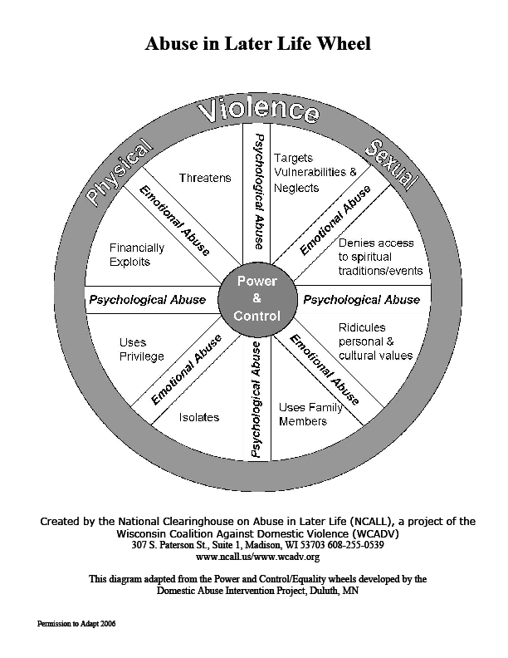
POWER & CONTROL WHEEL: HANDOUT #7
Module 8A Dynamics of Elder Abuse
Notes:
Bonnie, we need an original file with this.
34

Slide 35
POWER & CONTROL and APS
Why is understanding the power and control dynamic relevant to APS?
Victim and worker safety issues are at the forefront
Investigation & intervention strategies may be much more effective
Victims may be more receptive to help if they think APS truly understands their situation
APS is less likely to unknowingly collude with the abuser
35
Module 8A Dynamics of Elder Abuse
Notes:
35
35
35

Slide 36
DANGER IF APS ASSUMES CAREGIVER STRESS AND FAILS TO SEE POWER & CONTROL
Interventions to reduce stress, anger or substance abuse, or to provide in home services, will not stop the abuse as they do not address the underlying causes
Victim safety is not adequately addressed
APS may unknowingly collude with the abuser who continues the abuse, only now with outside help
Abusers will not be held accountable; the message is that elder abuse has no consequences
Module 8A Dynamics of Elder Abuse
36
36
Notes:
36
36

Slide 37
APS RESPONSIBILITY
To thoroughly investigate each case so as to distinguish between:
Truly incapacitated caregivers (who have dementia, etc.) and
Caregivers who claim to be “doing their best” but are in fact exercising power and control over the victim for their own ends
To intervene to protect the victim from further abuse to extent possible, while respecting victim’s right to self determination
Module 8A Dynamics of Elder Abuse
Notes:
37
37

Slide 38
10 MINUTES
LUNCH
- One Hour -
Module 8A Dynamics of Elder Abuse
38
Notes:
38
38

Slide 39
WHY VICTIMS STAY
OR REFUSE INTERVENTION
Module 8A Dynamics of Elder Abuse
Notes:
39
39
39

Slide 40
WHY VICTIMS STAY OR REFUSE INTERVENTION
Active Learning Activity &
Large Group Exercise
Why might an elder abuse victim choose to stay in, or return to, abusive situations?
Does it make a difference if the abuser is an adult child? a partner? a paid caregiver?
How do the victim’s actions affect the investigation? Is it frustrating for APS when victims don’t leave?
Module 8A Dynamics of Elder Abuse
40
Notes:
40
Trainer’s notes need to have something about worker frustration re this.
40

Slide 41
REASONS WHY VICTIMS
MIGHT STAY OR REFUSE HELP
Isolation: Many older persons are isolated due to mobility impairments, lack of transportation or the abuser’s own actions
Fear: victims may fear escalating abuse, abandonment or nursing home placement
Guilt
Desire to protect abuser
Religious convictions
Lack of resources (or information about resources which may be available)
Module 8A Dynamics of Elder Abuse
Notes:
41
41

Slide 42
COMINGS & GOINGS
Active Learning Activity
& Large Group Exercise
Each participant:
Is on their own in this activity
Is asked to listen to and follow instructions
Should not speak to others during exercise
Has varying amounts of resources
Must make and take responsibility for choices
Module 8A Dynamics of Elder Abuse
Notes:
42
42

Slide 43
Just To Have a Peaceful Life
Module 8A Dynamics of Elder Abuse
Notes:
43

Slide 44
MODULE 8A SUMMARY
Today we have:
Defined elder abuse as it applies to APS
Identified various dynamics underlying elder abuse
Explored APS’ role in and how dynamics might inform case interventions
Identified why some victims refuse services and remain with their abusers
Module 8A Dynamics of Elder Abuse
Notes:
44
44
44

Slide 45
Evaluation Process
All APS Training has evaluation components:
Demographic Survey
Satisfaction Survey
ID Code
45

Slide 46
DYNAMICS OF ELDER ABUSE
THANK YOU!
For more information contact NAPSA:
www.apsnetwork.org
Module 8A Dynamics of Elder Abuse
46
Notes:
46
46
46

