Slide 1


ETHICS, VALUES AND CULTURAL COMPETENCE
IN ADULT PROTECTIVE SERVICES
NCEA/NAPSA
Core Competencies Curriculum
MODULE # 2
For more information
:
For more information
For more information
:
:
Kathleen Quinn
Kathleen Quinn
Kathleen Quinn
National Adult Protective Services
National Adult Protective Services
National Adult Protective Services
Association
Association
Association
Phone: 720.565.0906
Phone: 720.565.0906
Email:
Phone: 720.565.0906
Email:
Email:
kathleen.quinn@apsnetwork.org
kathleen.quinn@apsnetwork.org
kathleen.quinn@apsnetwork.org

Slide 2
Address: National Center on Elder Abuse
c/o Center for Community Research and Services
University of Delaware
297 Graham Hall
Newark, DE 19716
Phone: 302-831-3525
Fax: 302-831-4225
Email: NCEA-info@aoa.hhs.gov
Web Site: www.ncea.aoa.gov
The National Center on Elder Abuse is funded by the
U.S. Administration on Aging Grant No. 90-AM--2792

Slide 3
This training is a product of the National Center on Elder Abuse (NCEA), which is funded in part by the U.S. Administration on Aging under Grant # 90-AM-2792. The project was developed by the National Adult Protective Services Association (NAPSA), and its contractor, the REFT Institute, Inc.
Grantees undertaking projects under government sponsorship are encouraged to express freely their findings and conclusions. Therefore, points of view or opinions do not necessarily represent official Administration on Aging policy. © NAPSA 2006

Slide 4

NATIONAL ADULT PROTECTIVE SERVICES ASSOCIATION
NAPSA is the only national organization which represents APS professionals, programs and clients
NAPSA is the National Voice of APS
NAPSA is a partner in the National Center on Elder Abuse
NAPSA has members in 49 states and DC

Slide 8

APS CORE COMPETENCIES
There are twenty-three modules in the Adult Protective Services (APS) Core Competencies identified by NAPSA.
This module, Ethics, Values and Cultural Competence in Adult Protective Services, is #2.

Slide 9

Ethics and Values in APS practice

Slide 10
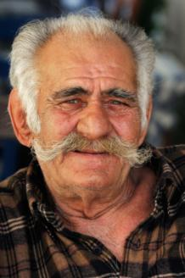
TRAINING GOALS
Provide a culturally competent ethical decision-making framework.
Increase ethical self-knowledge.
Increase knowledge and use of ethical multiculturalism principles.

Slide 11

LEARNING OBJECTIVES
Define 7 ethical concepts in APS work.
Describe 5 population changes that influence work with vulnerable adults.
List 4 major influences on APS decision-making.

Slide 12

LEARNING OBJECTIVES
Describe the cultural competence continuum.
Provide an example of using ethical multiculturalism principles.
List 5 parts of an ethical and culturally competent decision-making framework.

Slide 13
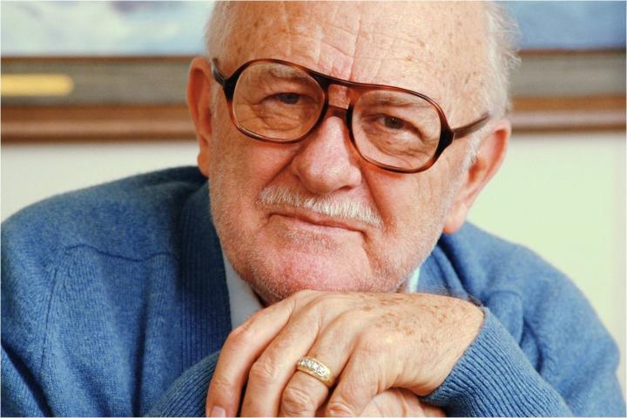
ETHICS CODES AND CONCEPTS

Slide 14

ACTIVE LEARNING #1: Large group
Brainstorming:
What are some ethical issues you confront in your daily practice?

Slide 15

ETHICS: Defined
“Good” or “right” conduct
Branch of philosophy dealing with values of human conduct
Useful in assessing the rightness of decisions and the fairness of the decision-making process

Slide 16

Ethics: code of ethics
Why do we need them?
How do they guide us professionally?

Slide 17

NASW Code of Ethics
Service
Social Justice
Individual Dignity
Human Relationships
Integrity
Competence

Slide 18

APS Guiding values
Every action taken by APS must balance the duty to protect with the right to self determination
Older people and people with disabilities who are victims of abuse, exploitation or neglect should be treated with honesty, caring and respect.

Slide 19
Napsa: aps ethical principles
Adults have the right to be safe.
Adults retain all their civil and constitutional rights unless some of these rights have been restricted by court action.
Adults have the right to accept or refuse services
Adults have the right to make decisions that do not conform with societal norms as long as these decisions do not harm others.
Adults are presumed to have decision-making capacity unless a court adjudicates otherwise.

Slide 20

Ethical concepts
Autonomy
Beneficence
Non-maleficence
Privacy
Fidelity
Accountability
Justice

Slide 21

Ethical concepts: Autonomy
Right of individuals to make choices as long as they have decision-making capacity and cause no harm to others. Decisions should be voluntary, intentional and not due to coercion, duress, or undue influence.
APS Workers: Respect the client’s self- determination.

Slide 22
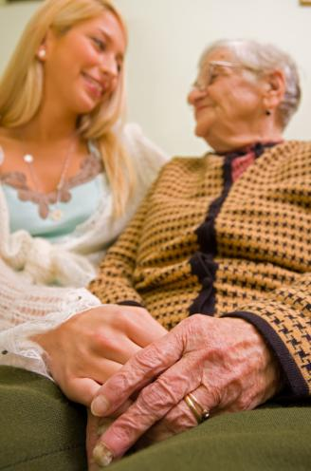
Ethical concepts: Beneficence
Right to receive care by others that maintains and/or enhances the client’s welfare.
APS Workers: Do good for others. Promote the welfare of others.

Slide 23

Ethical concepts: Non-maleficence
Right to expect others to “do no harm” in the maintenance or enhancement of the client’s welfare
APS Workers: Do not act in a way that will inflict harm on others. Weigh out all the possible consequences of your actions.

Slide 24

Ethical concepts: privacy
Right to maintain privacy regarding personal information, interpersonal relationships, physical environment, and lifestyle, as long as it does not infringe on the rights of others.
APS Workers: Respect client’s right to control information about him/herself.

Slide 25

Ethical concepts: Fidelity
Right to have others show loyalty or commitment to the client when they need help.
Right and responsibility of family members to care for and assist one another (e.g. filial piety).
APS Workers: Include and respect ideas of family members and significant others.

Slide 26

Ethical concepts: Accountability
Right to expect others to tell the truth and be responsible for their actions.
Right to expect others to expose the deception and irresponsibility of others.
APS Workers: Be accountable and responsible for your actions and expect others to do the same.

Slide 27

Ethical concepts: Justice
Right to be treated equitably whether they are a caregiver or care receiver.
APS Workers: Fairly distribute benefits (or costs or harms) among individuals.

Slide 28

Ethical concepts: Impact
Typical problems begin with specific situations:
  Limited, specific, individual focus, requiring…
  Limited, specific, individual answers.
At the same time, we use a set of standards in order to analyze situations.

Slide 29

ETHICAL DILEMMA

Slide 30


Ethical dilemma: definition
An ethical dilemma presents a choice between two relevant sets of values, two good things.
OR

Slide 31

ACTIVE LEARNING #2
Large Group Exercise
Individually read scenarios on handout.
Share ethical issues and dilemmas found with large group.

Slide 32

ACTIVE LEARNING #3
Small groups discuss one influence
Report shared with large group
Large group brainstorming of strategies

Slide 33
FACTORS INFLUENCING DECISION-MAKING
Client wishes
Professional obligations
Personal values
Community pressure

Slide 34

ETHICAL MULTICULTURALISM IN APS PRACTICE

Slide 35

Changes in the United States

Slide 36
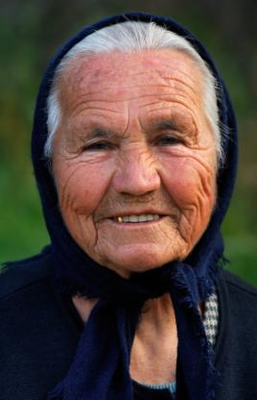
POPULATION IS CHANGING
More elders as Baby Boomers age
More racially and ethnically diverse elders
More elders who were born in other countries
More vulnerable adults

Slide 37
POPULATION CHANGES
Baby Boomers (65+)

Slide 38
POPULATION CHANGES
Population Ethnicity (65+)

Slide 39
POPULATION CHANGES
More Diverse Immigrants

Slide 40
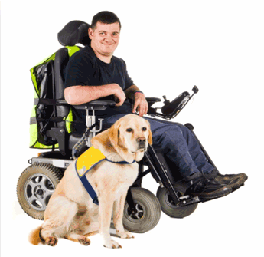
POPULATION: Impacts of Changes
Greater cultural differences among our vulnerable adults add to differences already created by:
  Age
  Disabilities
  Race
  Ethnicity
  Religion
  Social class
  Gender
  Sexual orientation

Slide 41

POPULATION: Impacts of Changes
The U.S. is no longer a “melting pot” but a dynamic multicultural nation.
There are cultural groups that are keeping their identity and others that are blended.
All contribute to the rich strength of this nation.

Slide 42

CHANGES IN CONTEXT
Funding is changing.
Service demands are changing.
Accountability is changing.

Slide 43

CONTEXT: Impacts of Change
It will be harder to find “standard responses” to the ethical dilemmas APS workers will face.

Slide 44
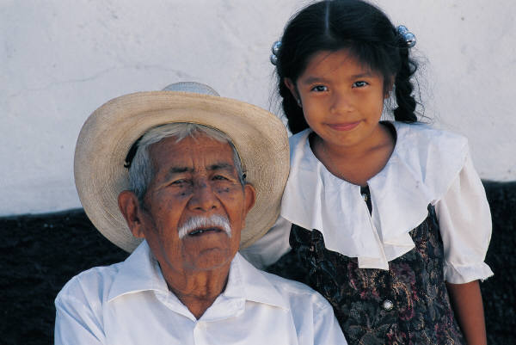
DEVELOPING CULTURAL INTELLIGENCE

Slide 45

UNDERSTANDING SELF
Become culturally competent
in your use of ethical multiculturalism!

Slide 46
What does culture have to do with this?
CULTURE is “that complex whole which includes knowledge, belief, art, morals, law, custom, and any other capabilities and habits than can only be acquired by [an individual] as a member of society.”
Source: Tyler 1988.
We are ALL socialized (e.g., raised by our parents/caregivers) into our respective cultures.

Slide 47



CULTURAL INTELLIGENCE: Defined
Cultural intelligence is the ability to successfully function in environments where individuals have experienced different [cultural training].
Source: Offermann and Phan 2002.

Slide 48

CULTURAL INTELLIGENCE: Characteristics
Uses the knowledge and skills APS workers already have.
Understands one’s own learned values and biases.
Understands others.
Matches appropriate behaviors and expectations to the situation.

Slide 49

CULTURAL INTELLIGENCE: Understanding Self
Culture hides much more than it reveals, and, strangely, it hides itself most effectively from its own participants. The real job is not to understand [other] cultures, but to understand one’s own.
Source: Offerman and Phan 2002

Slide 50

CULTURAL INTELLIGENCE
The Cultural Iceberg

Slide 51
ACTIVE LEARNING # 4
Self reflection on social groups
Small group sharing
Guided activity
Self-reflection
Large group debriefing

Slide 52


Slide 53
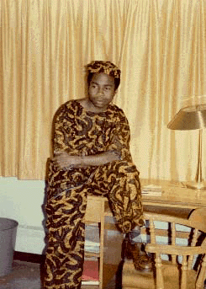

Slide 54
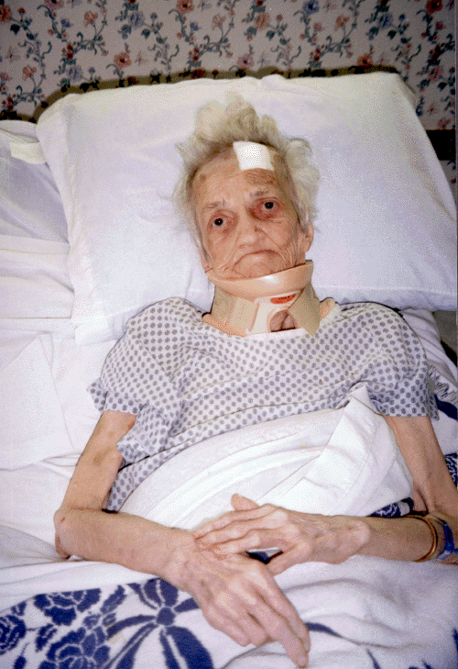

Slide 55

CULTURAL INTELLIGENCE: Understanding Self
Some of the values of mainstream American culture include:
  Primary importance of the individual
  Happiness orientation
  Equality orientation
  Practicality
  Change orientation
  Achievement orientation
  Data-driven decision-making
  Source: Hoppe 1998.

Slide 56

CULTURAL INTELLIGENCE: Understanding Others
This process:
Often starts with cultural blindness.
Develops cultural awareness, appreciation of diversity.
Develops cultural knowledge about cultural differences and their impacts on attitudes and behaviors.

Slide 57

CULTURAL INTELLIGENCE: Understanding Others
This process continues:
Develop cultural sensitivity by showing understanding, and non-judgmental respect for and acceptance of different viewpoints.
Develop cultural competence by showing empathy in understanding more fully how others perceive and experience the world.

Slide 58
CULTURAL COMPETENCE CONTINUUM
Cultural Proficiency
Cultural Blindness
Cultural Competence
Cultural Sensitivity
Cultural Knowledge
Cultural Awareness

Slide 59

CULTURAL COMPETENCE Means
The APS worker flexibly and skillfully responds and adapts when in a different cultural situation than his or her own.
The APS worker understands and uses his or her own skills and knowledge in culturally congruent ways.

Slide 60

ETHICAL MULTICULTURALISM

Slide 61

How do cultural competence and ethics work together in APS practice?

Slide 62
ETHICAL MULTICULTURALISM: Definition
Ethical multiculturalism takes fundamental ethical principles and applies them in a culturally relevant manner.
Source: Harper 2006

Slide 63

ETHICAL MULTICULTURALISM
Characteristics
Middle ground between two competing approaches to ethics:
  Absolutism = ethical principles are universally applicable, or
  Relativism = ethical principles are culturally bound and context dependent.
  Source: Harper 2006.

Slide 64
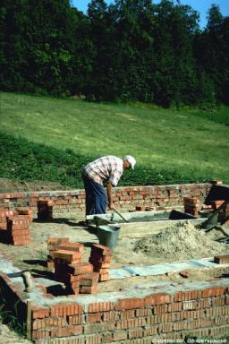
ETHICAL MULTICULTURALISM
Foundational Principles
Foundational ethical principles:
  Respect for persons, community, autonomy
  Beneficence
  Justice
Additionally:
  Caring
Source: Harper 2006

Slide 65

ETHICAL MULTICULTURALISM
In Practice
Skills needed:
  Understanding the underlying intent of an ethical principle
  Ability to analyze how the underlying intent can occur in a specific cultural situation

Slide 66

ETHICAL MULTICULTURALISM
In Practice
Autonomy analysis: Who is the fundamental decision-making unit in the culture? To whom are they accountable?
Beneficence analysis: Whose welfare is being promoted in this cultural situation?

Slide 67
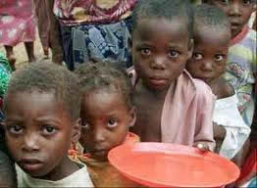
ETHICAL MULTICULTURALISM
In Practice
Justice analysis: What is a “fair” distribution of benefits and negatives of the services in this cultural situation?

Slide 68

ETHICAL MULTICULTURALISM
In Practice
Caring analysis. What is experienced as caring in this cultural situation? What norms guide interpersonal interactions?

Slide 69

CULTURAL COMPETENCE
Being culturally competent is essential in order to apply ethical multiculturalism in APS Practice!

Slide 70

FRAMEWORK
Ethical and Culturally
Competent Decision-Making

Slide 71

ACTIVE LEARNING # 5
Making ethical and culturally competent decisions in APS Practice
Case Study
  Small group and large group discussions and sharing

Slide 72
FRAMEWORK FOR Decision-making
OVERVIEW OF STEPS:
Define the problem.
Identify stakeholders and their cultural backgrounds.
Identify relevant ethical and cultural principles involved in case.
Brainstorm possible options and actions.

Slide 73
FRAMEWORK FOR Decision-making
Select the most appropriate action(s).
Evaluate your selected solution.
Document your plan of action.
Be open and flexible to revision when appropriate.

Slide 74

FRAMEWORK: Defining the Problem
Examine it from all sides.
Obtain as much information as possible.
Evaluate your sources of information.
Identify different cultural interpretations of facts.
Separate facts from opinions, beliefs, theories held by all.

Slide 75
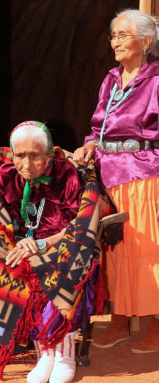
FRAMEWORK: Identify stakeholders
Take into account the individuals, families, communities and agencies that are involved in the situation.
Understand their relationship to the client, including their motivation and influence on the client.
Assess how the decision(s) may affect them all.

Slide 76

FRAMEWORK: Identify concepts and standards
Determine the conflicts and dilemmas presented.
Be aware of your own personal values.
Remember your professional values.
Consider the values of the stakeholders and how they may perceive the situation.

Slide 77
FRAMEWORK: Brainstorm options
Determine benefits and burdens of each possible action for all involved.
Eliminate the impractical, inappropriate, illegal.
Obtain stakeholders’ input.
Ask for consultation.

Slide 78

FRAMEWORK: Select most appropriate action
Find an acceptable balance that meets the challenge.
Look at the long term as well as the immediate fix.
Reduce as much harm as possible to all involved.

Slide 79

FRAMEWORK: Evaluate your solution
Put yourself in the situation and see how it feels.
Run it by your supervisor.
Imagine the media getting a hold of the story: plan your response.

Slide 80

FRAMEWORK: Document action plan
Make a systematic step by step outline.
Plan how you will deal with those who disagree with you.
Follow up and monitor your plan.
Be willing to accept new credible information and change your course of action.

Slide 81
CASE STUDY
Making Ethical and Culturally Competent Decisions
Choose a recorder.
Use the framework to develop a plan of action.
Listen to and respect ideas of all group members (brainstorm).
Document your plan in writing.
Be prepared to defend it.

Slide 82

THANK YOU FOR YOUR ATTENTION!
Please remember to complete the course evaluation.

